Slide 1

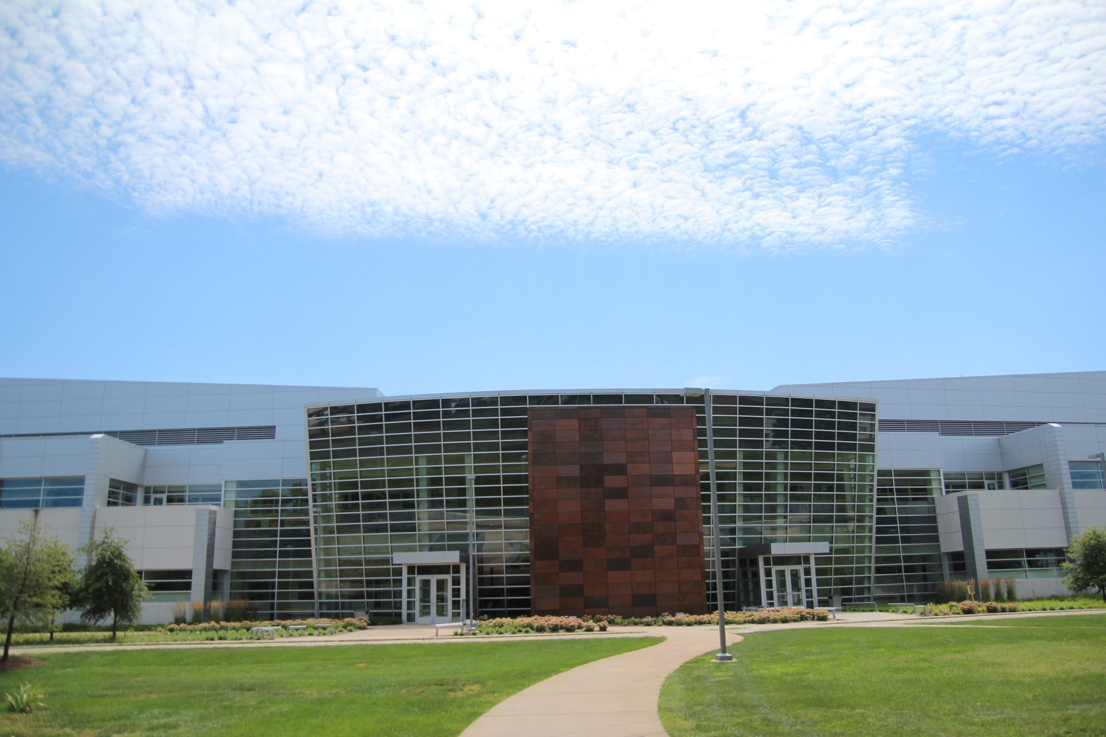

s
Birck Nanotechnology Center
Polymer Design for Wearable Fabric Electronics, High Power Dielectrics and Hemp Derived Thermoplastic Biomaterials
Prof. Gregory A. Sotzing
Polymer Program and Department of Chemistry
University of Connecticut
Friday April 29th, 2022
11:00am – 12:00pm
In Person : BRK 1001
Virtual: https://purdue-edu.zoom.us/j/96743534279
Abstract:
This presentation will feature the elements of polymer molecular design for engineering applications relating to flexible and stretchable electronics, dielectric films for high energy density capacitors operating under extreme temperature conditions, and for a new class of polymers as potential biomaterials and possibly commodity thermoplastics based upon the polymerization of cannabinoids such as cannabidiol (CBD) and cannabigerol (CBG), two cannabinoids predominantly found in hemp. Prototypes for wearable electronics include electronic color-change fabric for pixelated fabric displays, Wi-Fi, radar, ECG, EMG, electrodermal activity (EDA), resistive heating, wires for carrying >200W AC, power generation, and a recent demonstration of the fabrics to perform as a loudspeaker patch in collaboration with Purdue engineers. Design for dielectrics with operation across broad temperature range based upon the concept of facile low-energy localized rotations despite high Tg (long persistence length). These polymer glasses exhibit temperature range for high energy density and low loss in going from -160C to 200C, without change in dielectric constant. These dielectric polymers have application in capacitors used for various applications such as electromagnetic aircraft launch systems, hybrid jets, and power burst needs at high altitudes and/or moon/space. Further, in efforts to find body- and environmentally-friendly polymers, we have polymerized common cannabinoids found in the hemp plant. With the cannabis market booming at 40% CAGR, increased hemp crop production, and dropping cannabidiol (CBD) prices, polycannabinoids could be an alternative or enhancer to polyhydroxybutanoates (PHB) and polylactic acid (PLA). PolyCBD-adipate is a hemp derived thermoplastic made from the FDA approved drug and nutraceutical ingredient CBD as well as the food-approved ingredient adipic acid. This polymer was found to be a nonphenolic polymer anti-oxidant, possibly the first of its kind, and not cytotoxic in side-by-side comparisons with Tissue Culture Plastic and PLA. PolyCBD-Adipate decomposes back to the monomers of CBD and adipic acid when heated at pH = 10 for approximately 7 days. Unlike other biomaterials, there is tremendous flexibility in the tuning of polycannabinoid glass transition temperature (Tg), from -30 to 100C, since cannabinoids consist of aromatic and other unsaturated/saturated aliphatic ring systems.
Bio:
Gregory Sotzing, U. Connecticut Professor of Chemistry and Polymer Science, His research interests include Electrochromic Polymers: polymers that change color as a function of adding or removing charge. Design of polymers that allow various color transitions such as blue to colorless, red to colorless and green to colorless, without sacrificing polymer processability. Electrochromic solid-state fabric has been made for a host of applications including pixelated displays. Highly electrically conductive polymers as screen printed coatings for smart textiles. Recently, he is inventor on a patent that has published on Polymers made from Cannabinoids as biomaterials and for drug delivery. Over the past decade, he has been involved in the Materials Genome – research and development of dielectric polymers for high energy density under harsh electrification conditions. Professor Sotzing is also Founder and CSO of 3BC Inc., Founder and CSO of PcTRx Inc., and on the SAB of Grace Health and Wellness with involvement in research for a treatment for breast cancer. 48 patents.

