Slide 1

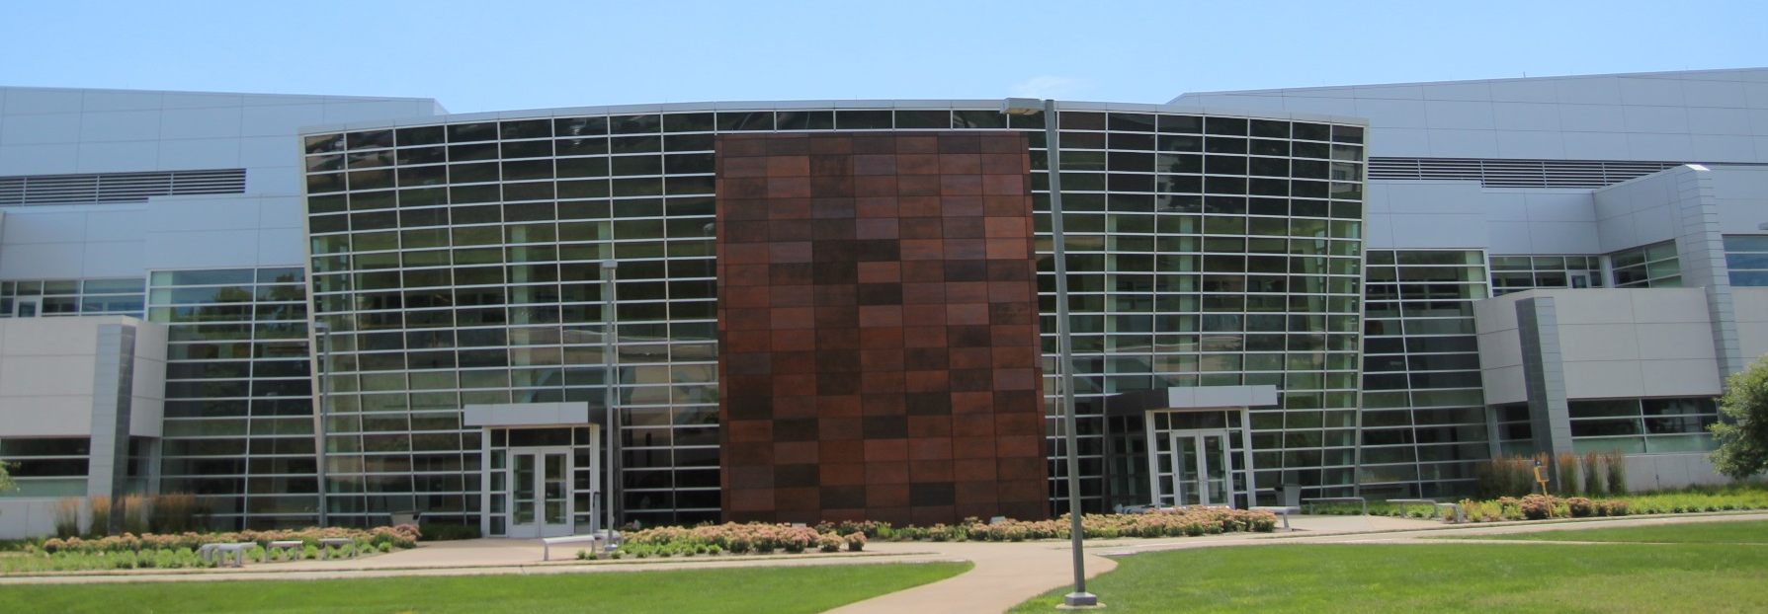
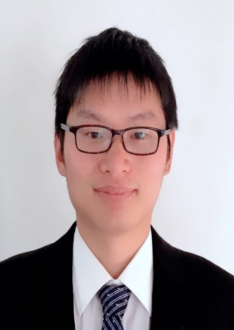

Birck Nanotechnology Center
Faculty Seminar Series
Xiaoping Bao, Ph.D.
Davidson School of Chemical Engineering,
Purdue Center for Cancer Research
Thursday, October 14th, 2021
12:00pm – 1:00pm, Zoom
https://purdue-edu.zoom.us/j/98695180597
Engineer and Manufacture Off-the-Shelf CAR-NK Cells for Targeted Cancer Immunotherapy
Abstract: Cancer is a major threat for humans worldwide, with over 18 million new cases and 9.6 million cancer-related deaths in 2018. Although most common cancer treatments include surgery, chemotherapy, and radiotherapy, unsatisfactory cure rates require new therapeutic approaches, particularly for refractory cancers. Adoptive cellular immunotherapies have employed several types of immune cells, including T lymphocytes and natural killer (NK) cells. NK cells are attractive because of their unique innate capability to elicit tumoricidal responses without the need for antigen presentation or prior sensitization. Unlike T cells, allogeneic NK cell transplantation does not cause graft-versus-host disease (GVHD), rendering it as a promising universal immunotherapeutic. Despite the significant potential of NK cell therapy, current clinical practices are limited by the need of large numbers of healthy NK cells, lack of in vivo persistence, and a burdensome manufacturing strategy that requires donor cell extraction, modulation, expansion, and re-introduction per each patient. The ability to generate universally histocompatible and genetically-enhanced NK cells from continuously renewable human pluripotent stem cell (hPSC) lines offers the potential to develop a true off-the-shelf cellular immunotherapy. The major focus of my current research is to engineer human pluripotent stem cells (hPSCs) for targeted cell and cancer therapies. In this talk, I will focus on our recent development of a chemically-defined platform for producing definitive hematopoietic stem and progenitor cells (HSPCs) and immune natural killer (NK) cells. In addition, we also genetically engineered hPSCs with brain tumor-targeted chimeric antigen receptors (CARs) as well as a universal FITC CAR and differentiated them into off-the-shelf CAR-NK cells for targeted immunotherapy. By reducing the complexity of hematopoietic induction, our approach will offer enhanced understanding of human embryonic hematopoiesis and expedite the manufacturing of hPSC-derived off-the-shelf CAR-NK and -T cells for targeted immunotherapy.
Bio: Dr. Bao is currently an assistant professor at the Davidson School of Chemical Engineering and a member of Purdue Center for Cancer Research. His research program at Purdue focuses on stem cell bioengineering and immunoengineering. Dr. Bao earned his B.S. degree from Tsinghua University in 2011 and his Ph.D. from University of Wisconsin-Madison in 2016. Prior to Purdue, Dr. Bao was a post-doc fellow at the University of California-Berkeley (2016 to 2018).

