Slide 1
Crane Lift Plan
WHEN: Friday, November 30, 2012, Approximately 7:00 a.m. – 4:00 p.m.
WHAT’S HAPPENING: A large air-handling unit is being lifted into the third-floor area of the Birck Nanotechnology Center as part of the bio-nano laboratory exhaust project
IMPACT ON FACILITY: No one is allowed to be in the areas underneath the swing radius of the crane
You may not go into any area under the swing radius during that time period

Slide 2
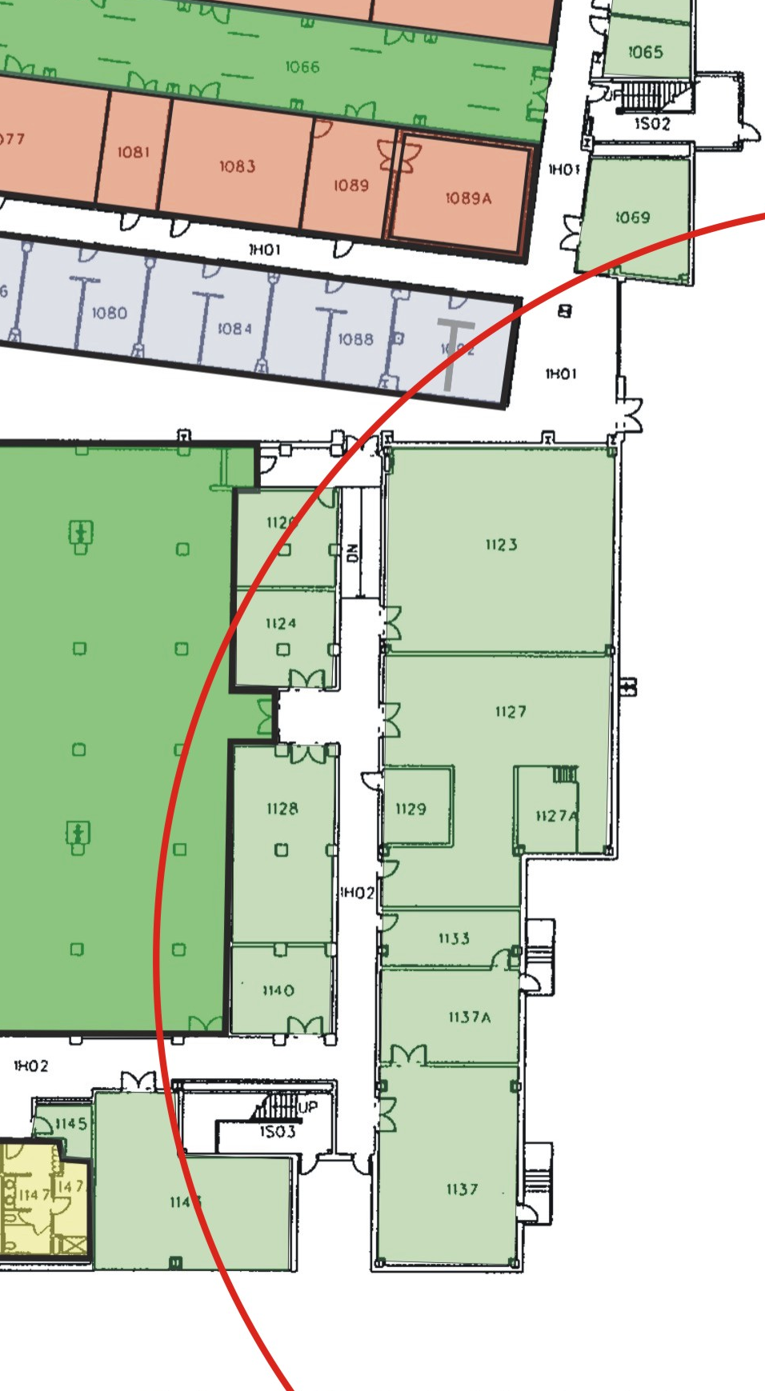
First Floor
Areas to be Evacuated
Nov. 30, 2012
7:00 a.m. – 4:00 p.m.
Storage Room BRK 1069
Lobby Area at east door
Student Office 1092
Siemens Control Room
Maintenance Break Area
Maintenance Shop
Housekeeping Area
Southeast Stairwell
Support Rooms 1123, 1127, 1127A, 1129, 1133, 1137, 1137A, 1143

Slide 3
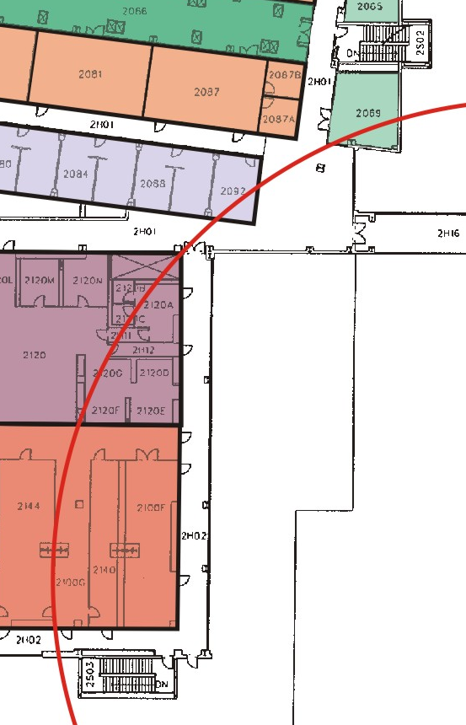
Second Floor
Areas to be Evacuated
Nov. 30, 2012
7:00 a.m. – 4:00 p.m.
Bindley-Birck Connector
Secretarial Station
Lab 2069
Lab 2092
Student Office 2088
East CR Tour Aisle
Biocleanroom
Cleanroom Bay F
Cleanroom Bay G
Cleanroom Chase FG
Southeast Stairwell

Slide 4
NOTE:
Please make arrangements for access to any items that you might need from those areas before Friday morning, November 30, 2012.

