Slide 1
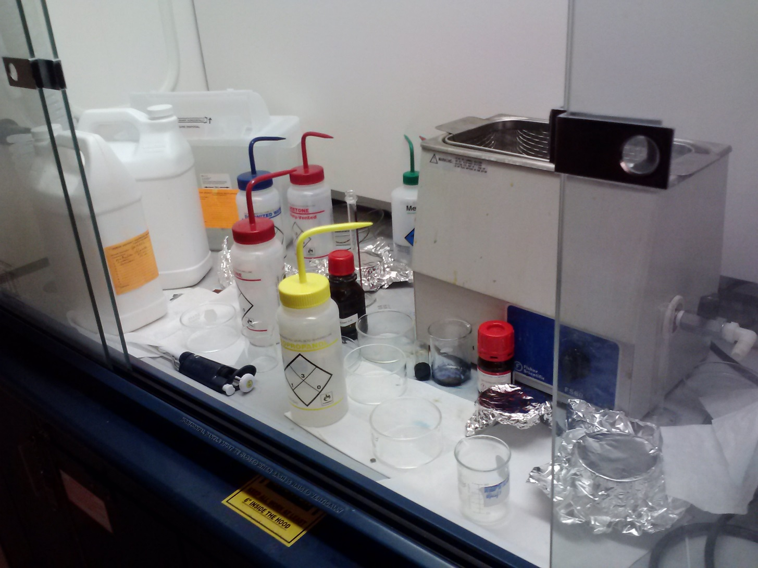
Birck Lab – 1227 solvent Hood
Issue - No safe work surface cluttered with empty glassware, chemical containers, aluminum foil etc.
Corrective action – Store chemicals and waste containers in cabinet below, remove glassware and dispose of foil and wipes. To be completed by 4/13/17

Slide 2
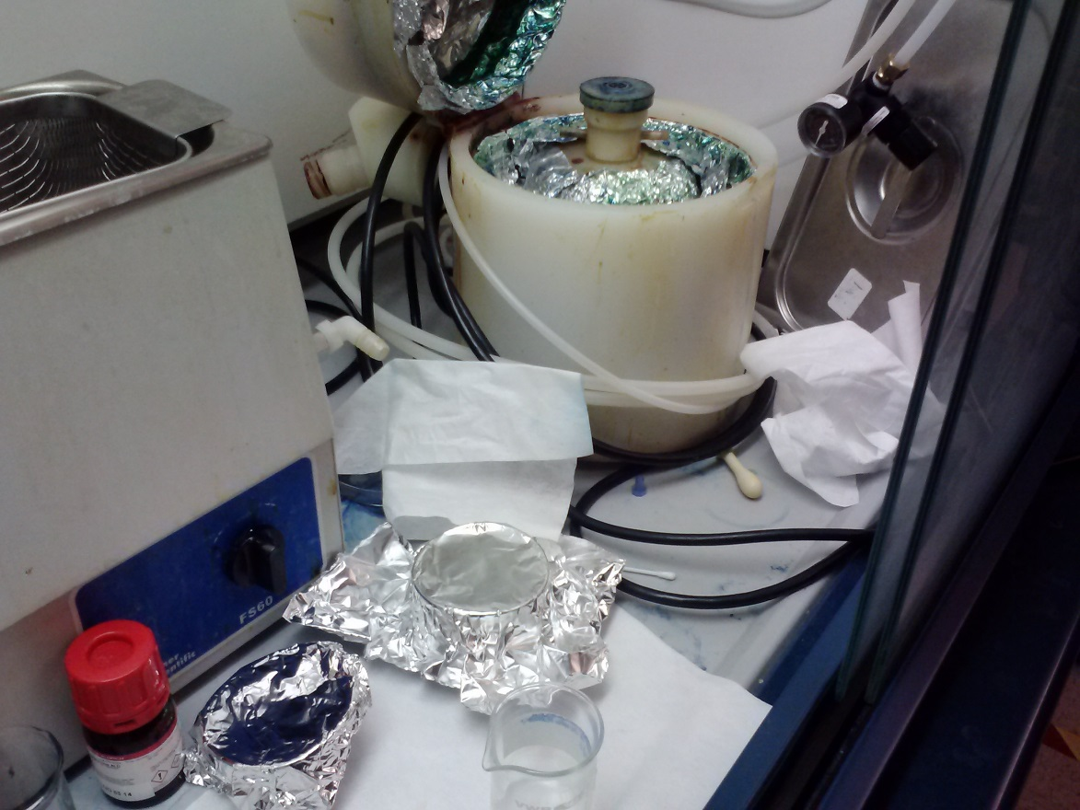
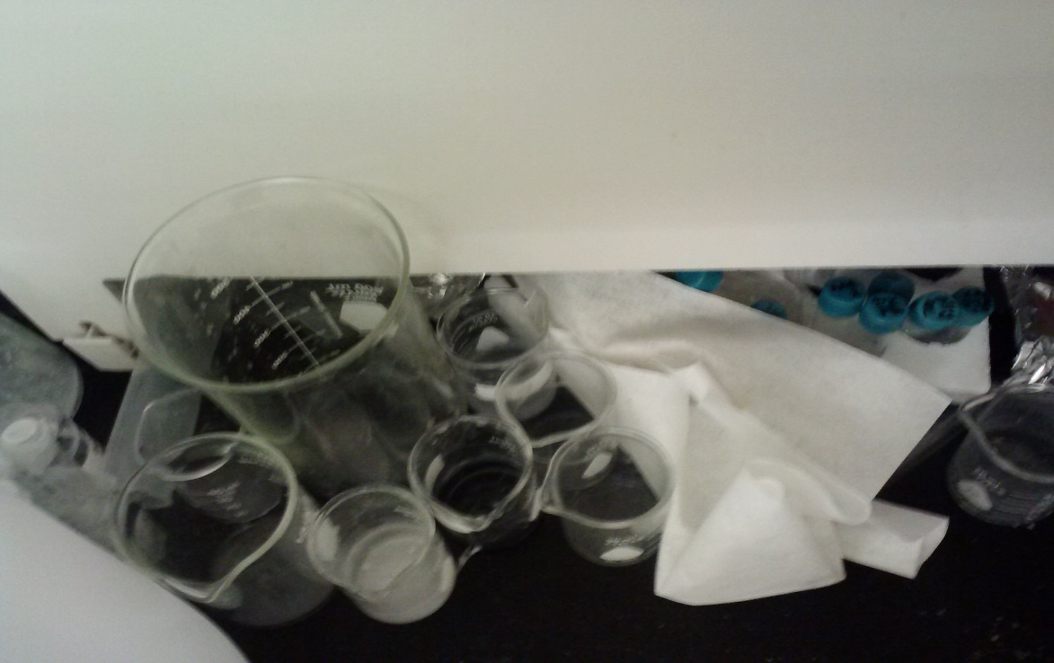
Birck Lab 1273 – Solvent Hood
Issue - No safe work surface cluttered with empty glassware, chemical containers, aluminum foil etc.
Corrective action – Store chemicals and waste containers in cabinet below, remove glassware and dispose of foil and wipes. To be completed by 4/13/17

Slide 3
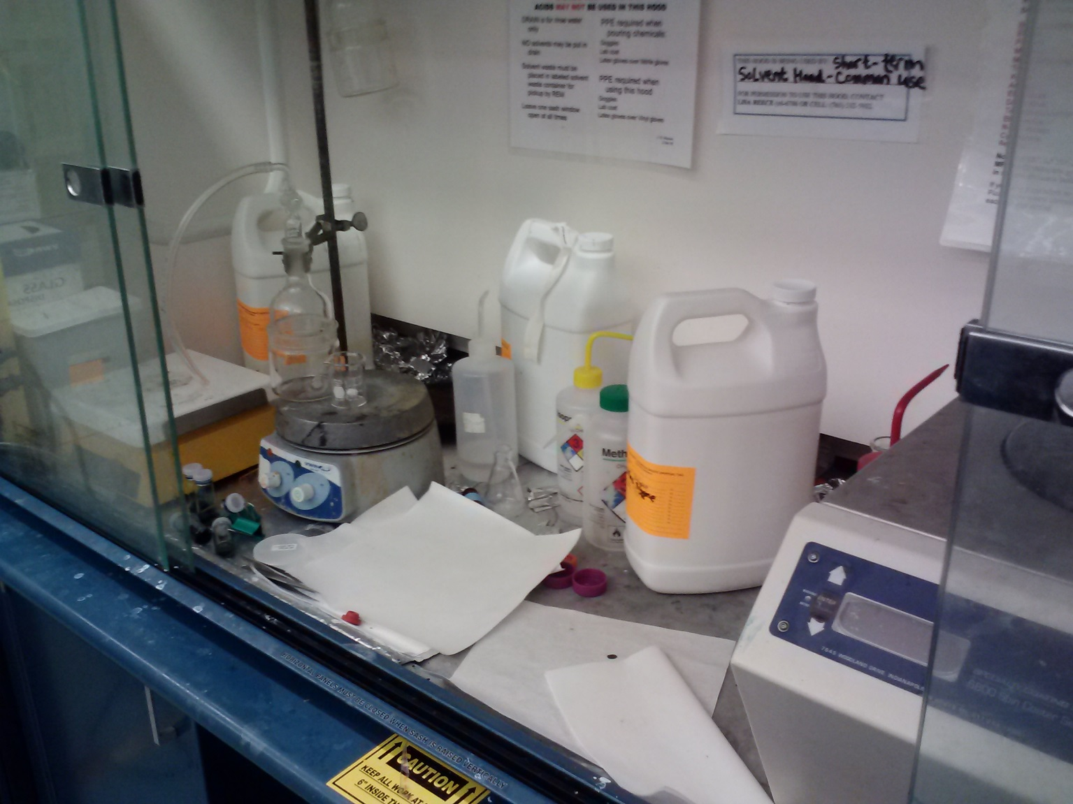
Birck Lab 2031 Solvent Hood A
Issue - No safe work surface cluttered with empty glassware/ experimental equipment, chemical containers, wipes etc.
Corrective action – Store chemicals and waste containers in cabinet below, remove glassware/ experimental equipment and dispose of wipes. To be completed by 4/13/17

Slide 4
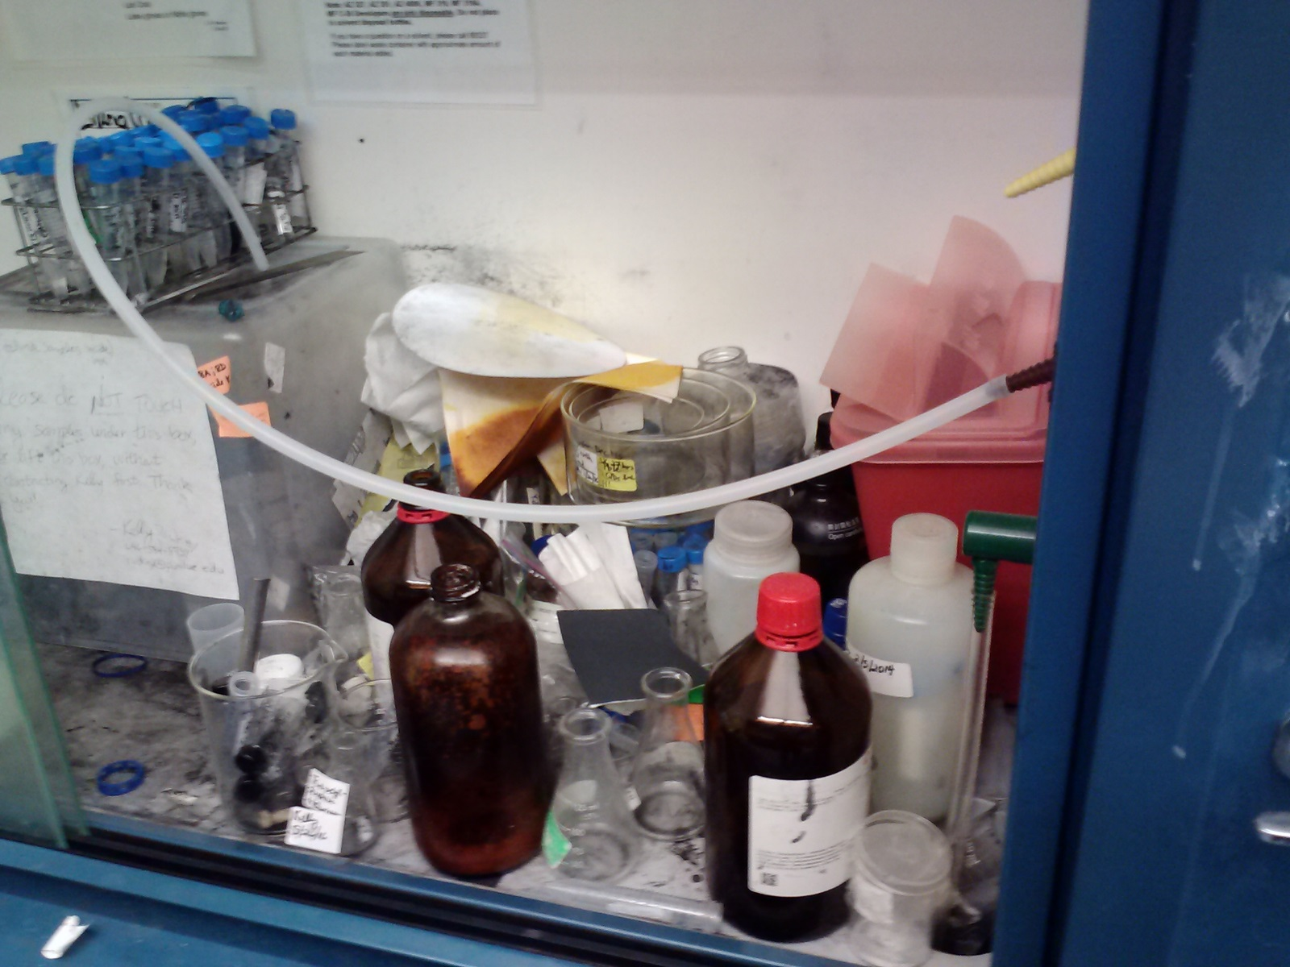
Birck Lab 2031 Solvent Hood D
Issue - No safe work surface cluttered with empty glassware/ experimental equipment, chemical containers, wipes and samples etc. Chemical contamination on work surface.
Corrective action – Store chemicals and waste containers and samples in cabinet below, remove glassware/ experimental equipment and dispose of empty bottles and wipes. Remove chemical contamination on work surface To be completed by 4/13/17

Slide 5
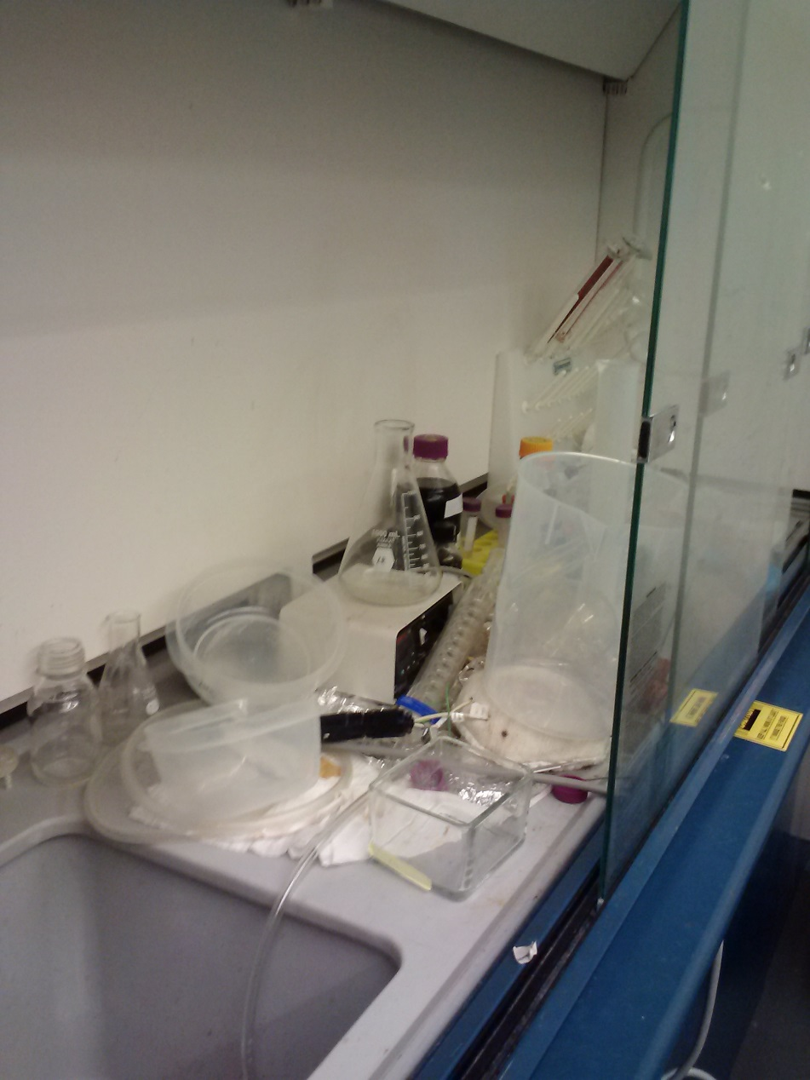
Birck 2043 East Hood
Issue - No safe work surface cluttered with empty glassware/ experimental equipment, chemical containers, wipes and plastic containers etc.
Corrective action – Store chemicals and waste containers and samples in cabinet below, remove glassware/ experimental equipment and dispose of plastic containers and wipes. To be completed by 4/13/17

Slide 6
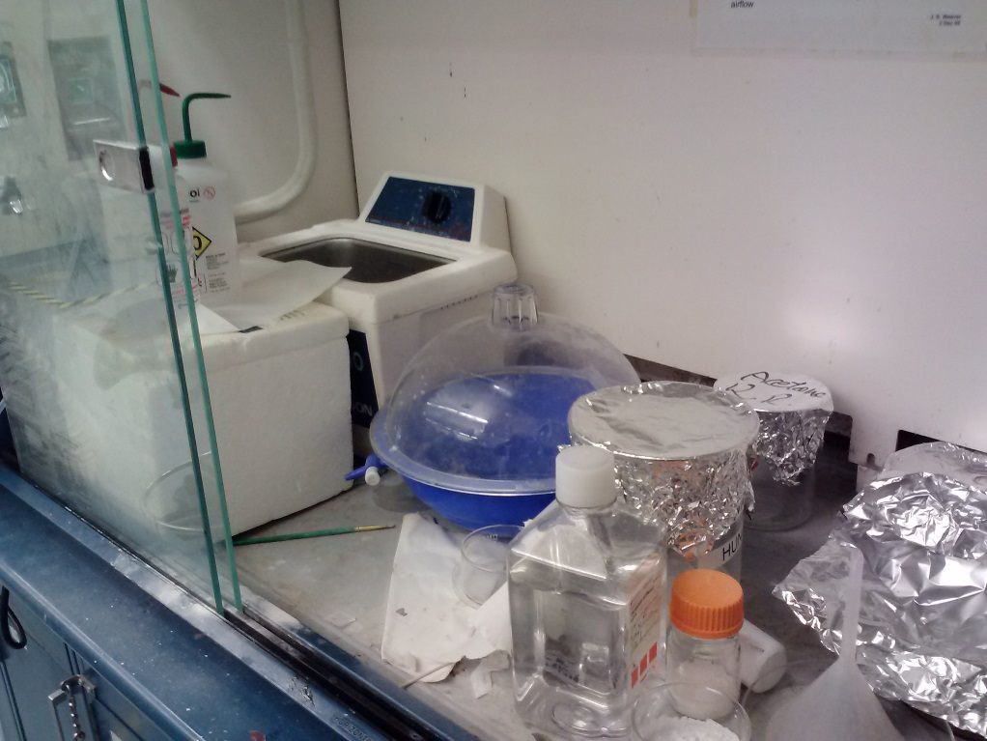
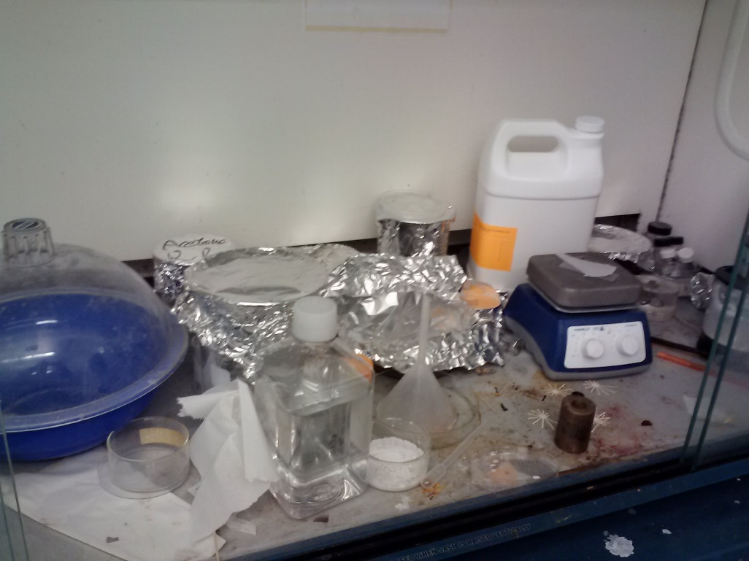
Birck 2081 Solvent Hood
Issue - No safe work surface cluttered with empty glassware/ experimental equipment, chemical containers, wipes and plastic containers etc. Chemical contamination to work surface.
Corrective action – Store chemicals and waste containers and samples in cabinet below, remove glassware/ experimental equipment and dispose of plastic containers and wipes. Clean surface contamination. To be completed by 4/13/17

