Slide 1
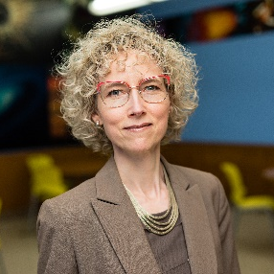




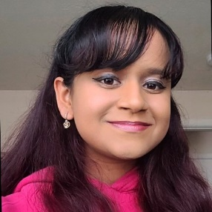
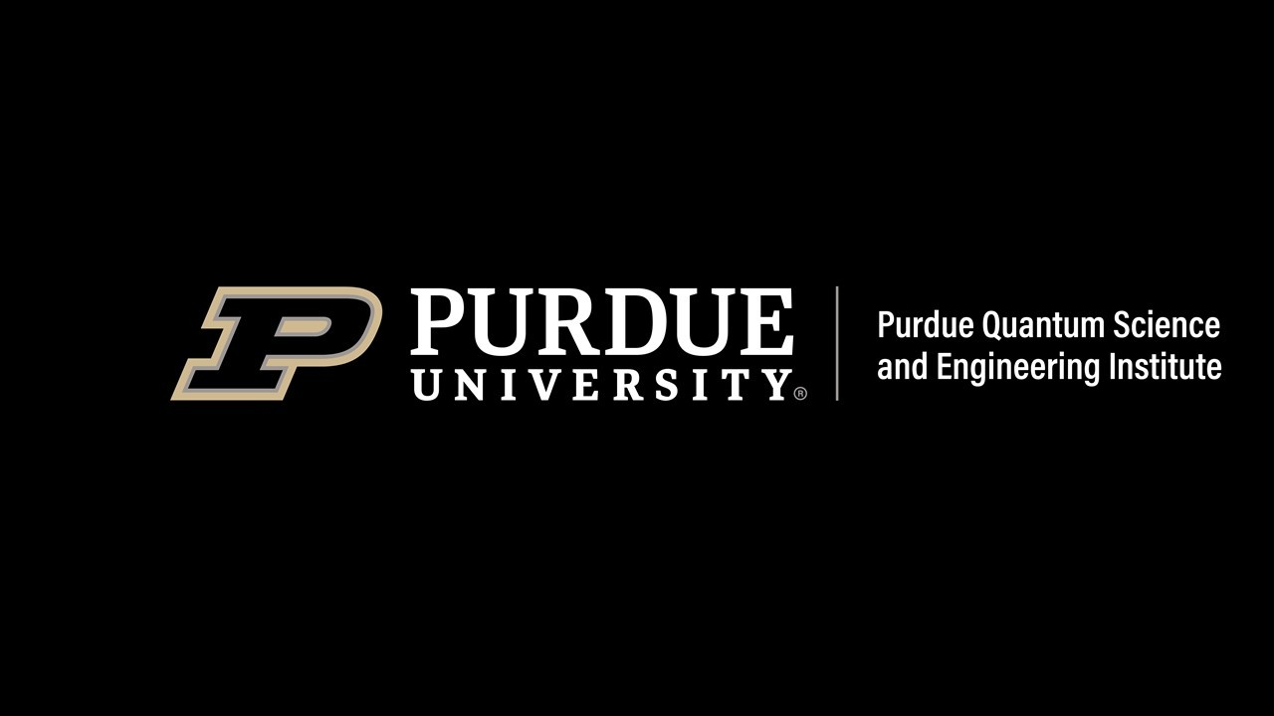
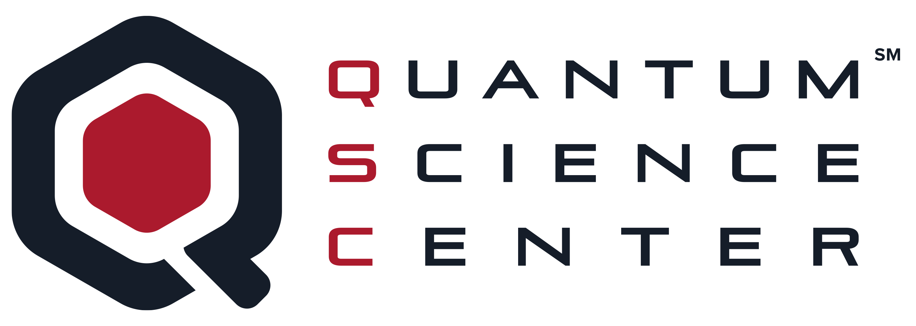
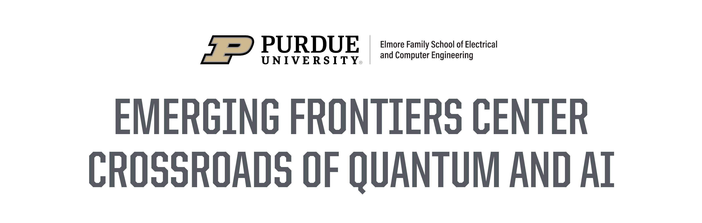
Lightning Talks: Special Topics in Quantum and Machine Learning
Monday February 5, 2024 -- 4:30EST
Tune in for a series of talks on use cases of new machine learning techniques in the emerging quantum technologies from faculty and students in pioneering research
Zoom: https://purdue-edu.zoom.us/j/97018048706
Prof. Erica Carlson
Dr. Frank (Po-Chen) Lin
Omer Yesilyurt
Blake Wilson
Michael Bezick and Vea Iyer

Slide 2
Professor Erica Carlson
Deep Learning Complexity in Neuromorphic Quantum Materials
Spatially resolved surface probes have recently revealed rich electronic textures at the nanoscale and mesoscale in many quantum materials. Rather than transitioning from insulator to metal all at once, VO₂ forms an intricate network of metallic puddles that extend like filigree over a wide range of temperatures. We developed a convolutional neural network to harvest information from both optical microscope and scanning near field optical images of the metallic filigree. The neural network was able to identify the factors that cause electrons to clump during the transition, such as interactions with defects in the material and the strength of the electron-electron interactions. This reveals that the intricate patterns share universal features with domain structures in magnets, stripe orientation fractals in superconductors, and antiferromagnetic domains in rare earth nickelates, pointing to a universal origin of electron clumping in quantum materials. This identification opens the door to using hysteresis effects to sculpt the filigree, in order to improve the function of VO₂ in novel electronic applications such as neuromorphic devices.

Slide 3
Dr. Frank (Po-Chen) Lin
Advancing Towards Quantum Federated Learning
In the face of machine learning's rapid adoption in diverse sectors like healthcare, transportation, and robotics, there's a growing call for techniques that enhance efficiency, scalability, and privacy. This talk demonstrates how federated learning meets these demands and explores quantum computing's potential to revolutionize privacy, security, and efficiency in machine learning processes.

Slide 4
Omer Yesilyurt
Deep Learning-Based Superconducting Qubit Readout
Achieving quantum computational advantage necessitates high-fidelity control and accurate readout of qubit systems, a requirement traditional state discriminators often fail to meet due to limitations in readout accuracy and scalability. This study introduces a neural network-based method designed for the readout of single qubits. We demonstrate that employing fully connected feedforward neural networks significantly elevates qubit-state-assignment fidelity up to 96%. Further, we investigate the deployment of a transformer-based anomaly detection system to identify various error mechanisms, thereby enhancing readout accuracy further. Our results indicate that the incorporation of sophisticated machine learning techniques markedly improves qubit readout performance, suggesting a scalable pathway for advancing quantum computing technologies.

Slide 5
Michael Bezick and Vea Iyer
Applications of Variational Neural Annealing for Machine Learning-Assisted Topology Optimization
Current complex scientific challenges can be reduced to combinatorial or topology optimization problems. Subsequently, simulated annealing involves minimizing a Boltzmann distribution to attain the ground state of a target Hamiltonian. Our research investigates variational neural annealing: a collection of classical and quantum autoregressive methods to efficiently map topology optimization problems to target domain spaces. We map to Quadratic/Polynomial Unconstrained Binary Optimization (QUBO/PUBO) and analogous problem spaces. We evaluate these solutions using models with flexible parameterization, like recurrent neural networks (RNNs) and variational Monte Carlo (VMC). Preliminary results show these methods’ utility, and their ability to assess optimization problems.

Slide 6
Blake Wilson
PyTorch Friendly Markov Chain Monte Carlo
Integrating physics-based simulations into machine learning frameworks allows us to leverage ideas from statistical mechanics for enhancing the sampling capability of machine learning models. I will present on a new package developed by the NanoML team for MCMC integration into PyTorch called nanomcmc.

