Slide 1
Mapping Circuit Fault diagnosis problems
Bian, et al., Frontiers in Physics 2:56, 2014.
Bian, et al., Frontiers in ICT 3:14, 2016.
Perdomo-Ortiz, et al., Phys. Rev. Appl. 12:1, 2019.
Brad Lackey
Microsoft Quantum
Notes:
We won’t be talking about hardware or algorithms to solve binary problems, or even benchmarking circuit fault diagnosis problems.
Rather we will only discuss how to create (in some sense optimal) Ising models that capture solving this problem, and by extension other similar problems.
There is literature benchmarking a variety of binary solvers (including quantum annealers) on circuit fault diagnosis problems.
Naturally, there is a huge literature on methods of for solving diagnosis problems in general.

Slide 2
Circuit Fault Diagnosis Problems

Slide 3

Fault diagnosis is widely studied
Fault Diagnosis is a broad topic
We will focus on hardware circuits
DX (Principles of Diagnosis workshop)
33Rd Annual Was in TOULOUSE (2022)
Named application in several programs
IARPA QEO
Darpa QAFS and Quicc
Benchmark libraries
ISCAS 85, iscas 89, and ITC 99.

Slide 4
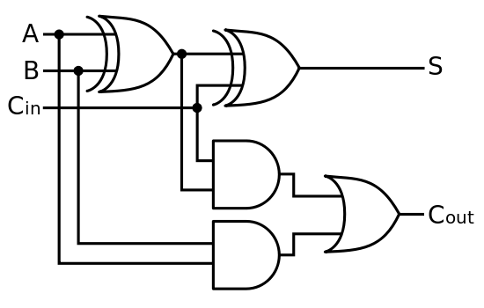

Consider a Circuit
For example, a full-adder
Broken gate
XOR gates
Suppose we have a Large circuit
There are many components
Connected by a complex network
X1
X2
OR gate
A1
But some of the components are Faulty
Strong model: they break in predictable ways
Weak model: we don’t care how they break
How do we find what broke?
O1
A2
AND gates

Slide 5
Circuit Fault diagnosis
Provide test vectors, make observations
Stuck-at-zero
Both outputs are incorrect
WE are provided test vectors:
Inputs (1,0,1) produce outputs (0,1).
Now make observations:
What does the circuit compute on the inputs?
(Minimal Cardinality) Fault Diagnosis:
  Find the least number of Faults
  That explain the observation.
1
1
X1
0
0
X2
1
0
0
1
1
1
A1
0
1
O1
0
1
0
A2
0
Notes:
Setting the state for the problem: we have a dictionary of input/output test vectors to check whether a design conforms to the desired behaviors.
If it does not (as in the case shown here), there are at least one components of the circuit that are unhealthy.
Imagining that component errors happen independently with low frequency, the most likely diagnoses are those where a minimum number of components in a fault mode.
For small examples, such as the one here, we can solve these by hand with a bit of reasoning (figure out where the faulty components must lie based on which outputs are wrong). If we were in the weak fault model, we would are done: we found a faulty component that explains the output. In the strong fault model, however, we would question if how our component breaks is compatible with what we expect.

Slide 6
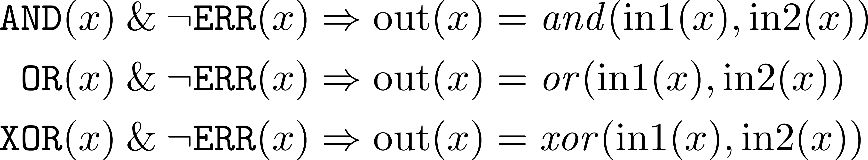
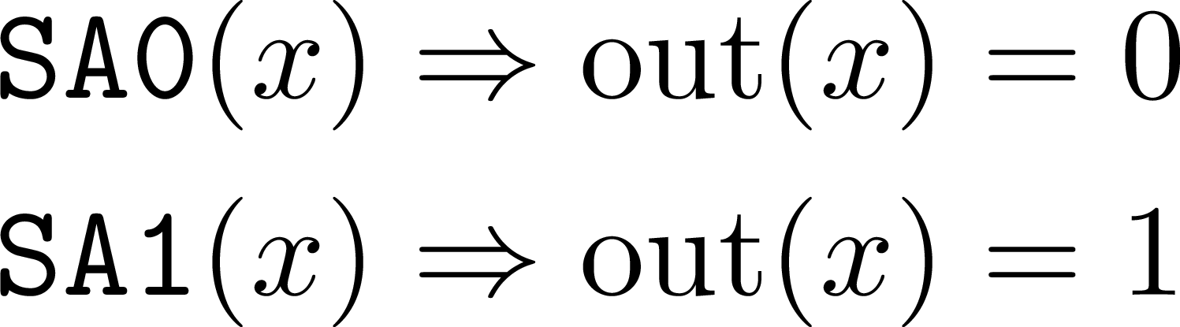
Circuit Fault Diagnosis
Strong Fault model
We can have multiple models of behavior.
Healthy: the component behaves correctly.
Faulty: The component fails predictably.
X1
X2
A1
O1
A2
XOR>SA0(X1)
Healthy it’s XOR
Broken it’s stuck-at-zero
Notes:
This is (simplification) of what would find in standard EDA, almost.
In our behaviors we specifically note that if a gate is health (not in error), then it obeys standard logic.
Fault diagnosis adds fault behaviors to gates.
We focus on two very simple faults, “stuck-at” faults, where the gate always outputs the same value irrespective of its inputs.
One could envision many other kinds of faults.
For our purposes here we require the faults to be deterministic: if a gate is at fault, it always behaves the same way (i.e. not randomly).

Slide 7
Hamiltonian Synthesis

Slide 8
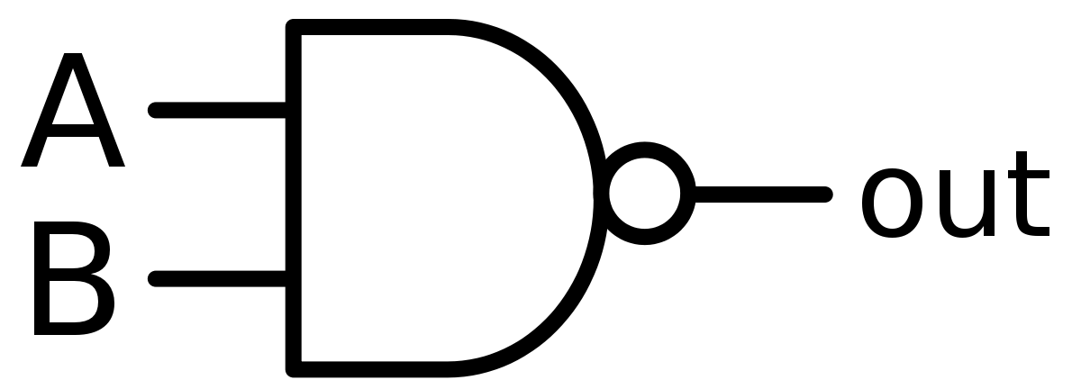
Example: a Nand gate
Healthy behavior
out | A | B | P
0 | 0 | 0 | 1
1 | 0 | 0 | 0
0 | 1 | 0 | 1
1 | 1 | 0 | 0
0 | 0 | 1 | 1
1 | 0 | 1 | 0
0 | 1 | 1 | 0
1 | 1 | 1 | 1
out | A | B
0 | 0 | 0
1 | 0 | 0
0 | 1 | 0
1 | 1 | 0
0 | 0 | 1
1 | 0 | 1
0 | 1 | 1
1 | 1 | 1
out | A | B
1 | 0 | 0
1 | 1 | 0
1 | 0 | 1
0 | 1 | 1
Let’s start with the truth table for a Nand gate.
Issue: when we have faults Inputs and outputs may be wrong.
Instead let’s list the “good” versus “bad” configurations.
We distinguish good and bad configurations with a penalty.
Good configurations receive no penalty.
Bad Configurations get the full penalty.

Slide 9
Example: a Nand gate
Healthy behavior
out | A | B | P
0 | 0 | 0 | 1
1 | 0 | 0 | 0
0 | 1 | 0 | 1
1 | 1 | 0 | 0
0 | 0 | 1 | 1
1 | 0 | 1 | 0
0 | 1 | 1 | 0
1 | 1 | 1 | 1
We want to capture the penalty with a formula.
These are often called “pseudo-Boolean” functions.
They have bits as inputs but real values as outputs.
Standard mathematical trick for this: “Lagrangian interpolation.”
For pseudo-Boolean functions this always give a polynomial
Ouch! A degree 3 term.

Slide 10
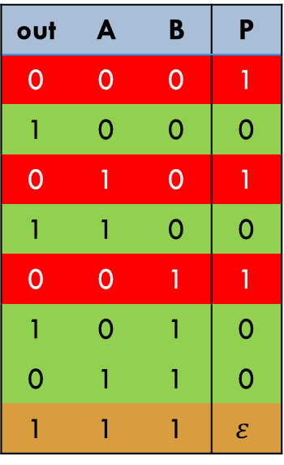
Example: a Nand>SA1 gate
Healthy behavior
out | A | B | P
0 | 0 | 0 | 1
1 | 0 | 0 | 0
0 | 1 | 0 | 1
1 | 1 | 0 | 0
0 | 0 | 1 | 1
1 | 0 | 1 | 0
0 | 1 | 1 | 0
1 | 1 | 1 | 1
out | A | B | P
0 | 0 | 0 | 1
1 | 0 | 0 | 0
0 | 1 | 0 | 1
1 | 1 | 0 | 0
0 | 0 | 1 | 1
1 | 0 | 1 | 0
0 | 1 | 1 | 0
1 | 1 | 1 | $$ε$$
Consider Our “NAnd” gate, with a stuck-at-one fault.
Four States belong to the healthy behavior.
  These receive a penalty of zero.
Three States are incompatible with the gate.
  These receive a penalty of one.
Now One State represents the valid fault Behavior.
  We Give this a “small” penalty.
Again, Lagrangian interpolation gives a Polynomial.
It’s a bit messy so I won’t print it here.
Notes:
To add a fault mode, there are two approaches.
The minimum one, is to directly insert the error behavior into the truth table of the circuit.

Slide 11


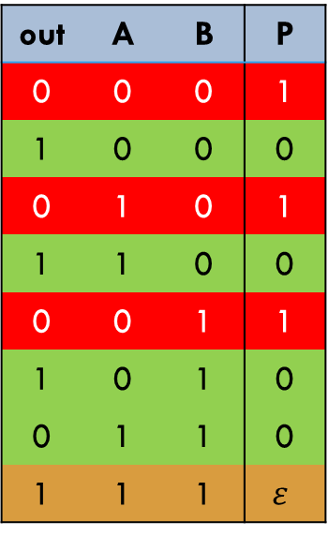

Hamiltonian synthesis
General ideas
Infeasible states
IN summary:
Healthy behaviors have no penalty
Faulty Behaviors have a small penalty
Infeasible states have a large Penalty
X1
X2
$$P≫0$$
out | A | B | P
0 | 0 | 0 | 1
1 | 0 | 0 | 0
0 | 1 | 0 | 1
1 | 1 | 0 | 0
0 | 0 | 1 | 1
1 | 0 | 1 | 0
0 | 1 | 1 | 0
1 | 1 | 1 | $$ε$$
A1
O1
A2
Faulty behaviors
For large circuits
Sum up the penalties of its components
$$P≳0$$
$$P=0$$
Healthy behaviors

Slide 12
Hamiltonian Synthesis
Adding Observations
We have not accounted for Observations
Add A Penalty if the output does not agree
$$P≫0$$
Finding the Lowest penalty solves the Diagnosis Problem.
1
0
X1
X2
1
0
1
A1
1
O1
0
Healthy Behavior now has a Penalty
The Diagnosis with Fewest faults Has the lowest Penalty
A2
$$P≳0$$
$$P=0$$
Notes:
Mapping a circuit fault diagnosis problems into a binary optimization problem is somewhat abnormal.
Ordinarily we would view the ground state as the desired solution we aim to find, and this will eventually be true.
However, to set up the problem we need address healthy behavior versus faulty behavior (on a graded scale by cardinality) versus configurations simply do not represent any way that the circuit operates.
Then, we encode our observations by adding a penalty to a configuration incompatible with what we observe on the given wires.
This pushes behaviors incompatible with the observation into excited states.
What is left as ground states are the (fault) behaviors compatible with the observations.

Slide 13
Reducing degree

Slide 14


Hamiltonian Synthesis
Desirable and Undesirable Features
Let’s Revisit our “NAnd” gate:
Our “Gap” is large (good)
  We have more room to insert Fault penalties
  Physics-based optimizers want a large spectral Gap
Our coefficients are not really big (Good)
Our Penalty function is cubic (Bad)
  Physical systems typically do not have strong many-body interactions
$$P≫0$$
out | A | B | P
0 | 0 | 0 | 1
1 | 0 | 0 | 0
0 | 1 | 0 | 1
1 | 1 | 0 | 0
0 | 0 | 1 | 1
1 | 0 | 1 | 0
0 | 1 | 1 | 0
1 | 1 | 1 | 1
$$P=0$$
Notes:
First consider describing the healthy behavior of a nand-gate.
Doing the most mathematically accessible mapping produces a cubic PUBO (and corresponding “third-order” Ising model).
There are standard methods to reduce to a QUBO (correspondingly a Ising model).

Slide 15

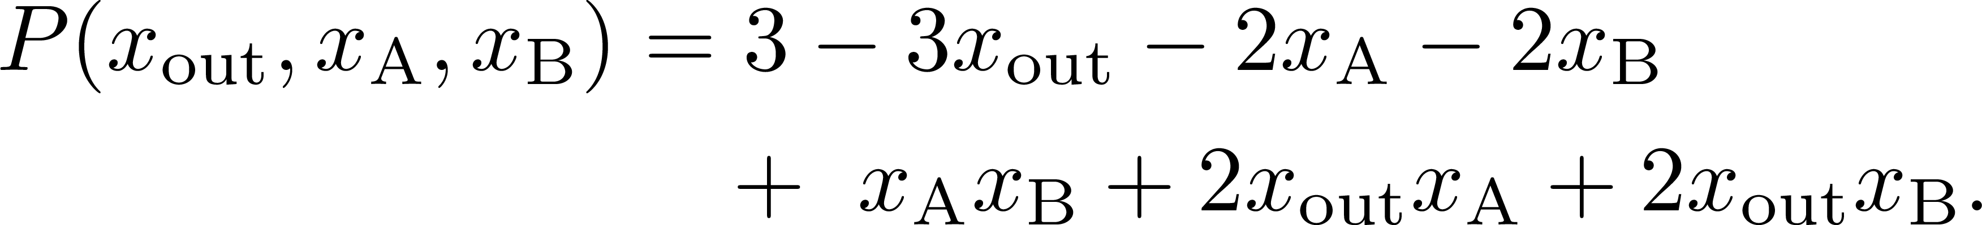
Hamiltonian Synthesis
Reducing Degree
There is a standard tricks to reduce degree:
Introduce an extra bit
We’ll do something different.
$$P≫0$$
out | A | B | P
0 | 0 | 0 | 1
1 | 0 | 0 | 0
0 | 1 | 0 | 1
1 | 1 | 0 | 0
0 | 0 | 1 | 1
1 | 0 | 1 | 0
0 | 1 | 1 | 0
1 | 1 | 1 | 1
out | A | B | P
0 | 0 | 0 | 3
1 | 0 | 0 | 0
0 | 1 | 0 | 1
1 | 1 | 0 | 0
0 | 0 | 1 | 1
1 | 0 | 1 | 0
0 | 1 | 1 | 0
1 | 1 | 1 | 1
$$P=0$$
Notes:
First consider describing the healthy behavior of a nand-gate.
Doing the most mathematically accessible mapping produces a cubic PUBO (and corresponding “third-order” Ising model).
There are standard methods to reduce to a QUBO (correspondingly a Ising model).

Slide 16
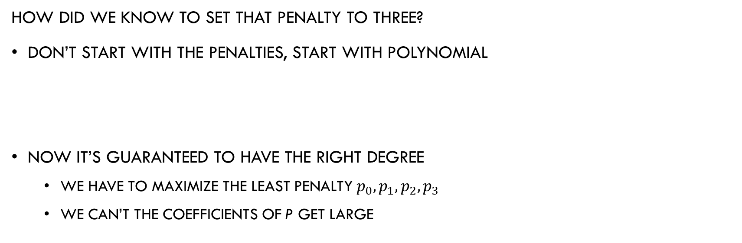
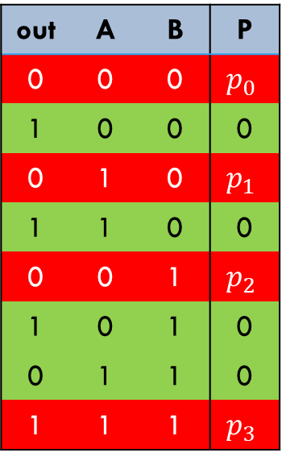
Hamiltonian Synthesis
Searching for Penalties
out | A | B | P
0 | 0 | 0 | $$p_{0}$$
1 | 0 | 0 | 0
0 | 1 | 0 | $$p_{1}$$
1 | 1 | 0 | 0
0 | 0 | 1 | $$p_{2}$$
1 | 0 | 1 | 0
0 | 1 | 1 | 0
1 | 1 | 1 | $$p_{3}$$
How did we know To set that penalty to three?
Don’t start with the penalties, start with polynomial
Now it’s guaranteed to have the right degree
  We have to maximize the least penalty $p_{0}, p_{1}, p_{2}, p_{3}$
  We can’t the coefficients of P get Large
$$P\left(x_{out},x_{A},x_{B}\right)=c_{0}+c_{1}x_{out}+c_{2}x_{A}+c_{3}x_{B}+c_{4}x_{A}x_{B}+c_{5}x_{out}x_{A}+c_{6}x_{out}x_{B}$$
Notes:
First consider describing the healthy behavior of a nand-gate.
Doing the most mathematically accessible mapping produces a cubic PUBO (and corresponding “third-order” Ising model).
There are standard methods to reduce to a QUBO (correspondingly a Ising model).

Slide 17
Gap Optimal Hamiltonians

Slide 18
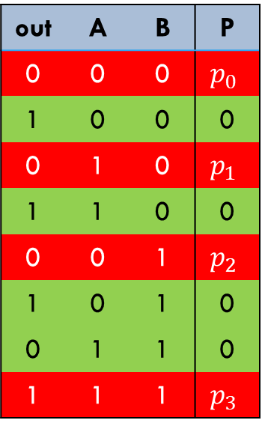
Hamiltonian Architecture
An architecture is A space of polynomials with coefficient bounds
Healthy behaviors gives equations for our coefficients:
$$P\left(x_{out},x_{A},x_{B}\right)=c_{0}+c_{1}x_{out}+c_{2}x_{A}+c_{3}x_{B}+c_{4}x_{A}x_{B}+c_{5}x_{out}x_{A}+c_{6}x_{out}x_{B}$$
out | A | B | P
0 | 0 | 0 | $$p_{0}$$
1 | 0 | 0 | 0
0 | 1 | 0 | $$p_{1}$$
1 | 1 | 0 | 0
0 | 0 | 1 | $$p_{2}$$
1 | 0 | 1 | 0
0 | 1 | 1 | 0
1 | 1 | 1 | $$p_{3}$$
$$0=c_{0}+c_{1}⋅1+c_{2}⋅0+c_{3}⋅0+c_{4}⋅0+c_{5}⋅0+c_{6}⋅0$$
$$0=c_{0}+c_{1}⋅1+c_{2}⋅1+c_{3}⋅0+c_{4}⋅0+c_{5}⋅1+c_{6}⋅0$$
$$0=c_{0}+c_{1}⋅1+c_{2}⋅0+c_{3}⋅1+c_{4}⋅0+c_{5}⋅0+c_{6}⋅1$$
$$0=c_{0}+c_{1}⋅0+c_{2}⋅1+c_{3}⋅1+c_{4}⋅1+c_{5}⋅0+c_{6}⋅0$$
Notes:
Really, an architecture is just a selection of bounds in our Hamilton coefficients.
We require the zero Hamiltonian be in any architecture for technical reasons.
Ising models, with a given interaction graph, can be specified by setting coefficient not supported by the model to zero.

Slide 19
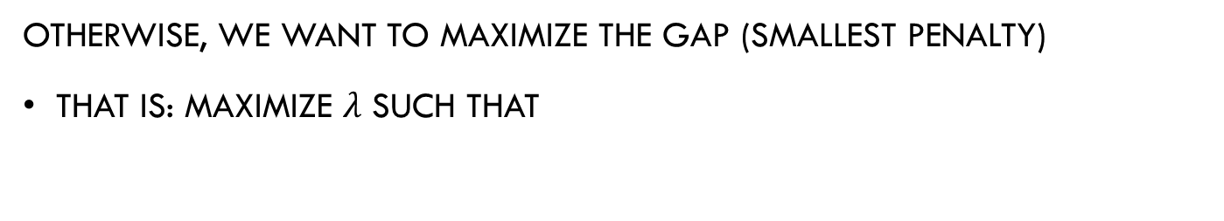
Gap Optimal Hamiltonians
Otherwise, we want to maximize the Gap (smallest penalty)
That is: maximize $λ$ Such that
out | A | B | P
0 | 0 | 0 | $$p_{0}$$
1 | 0 | 0 | 0
0 | 1 | 0 | $$p_{1}$$
1 | 1 | 0 | 0
0 | 0 | 1 | $$p_{2}$$
1 | 0 | 1 | 0
0 | 1 | 1 | 0
1 | 1 | 1 | $$p_{3}$$
$$λ≤c_{0}+c_{1}⋅0+c_{2}⋅0+c_{3}⋅0+c_{4}⋅0+c_{5}⋅0+c_{6}⋅0$$
$$λ≤c_{0}+c_{1}⋅0+c_{2}⋅1+c_{3}⋅0+c_{4}⋅0+c_{5}⋅0+c_{6}⋅0$$
$$λ≤c_{0}+c_{1}⋅0+c_{2}⋅0+c_{3}⋅1+c_{4}⋅0+c_{5}⋅0+c_{6}⋅0$$
$$λ≤c_{0}+c_{1}⋅1+c_{2}⋅1+c_{3}⋅1+c_{4}⋅1+c_{5}⋅1+c_{6}⋅1$$

Slide 20
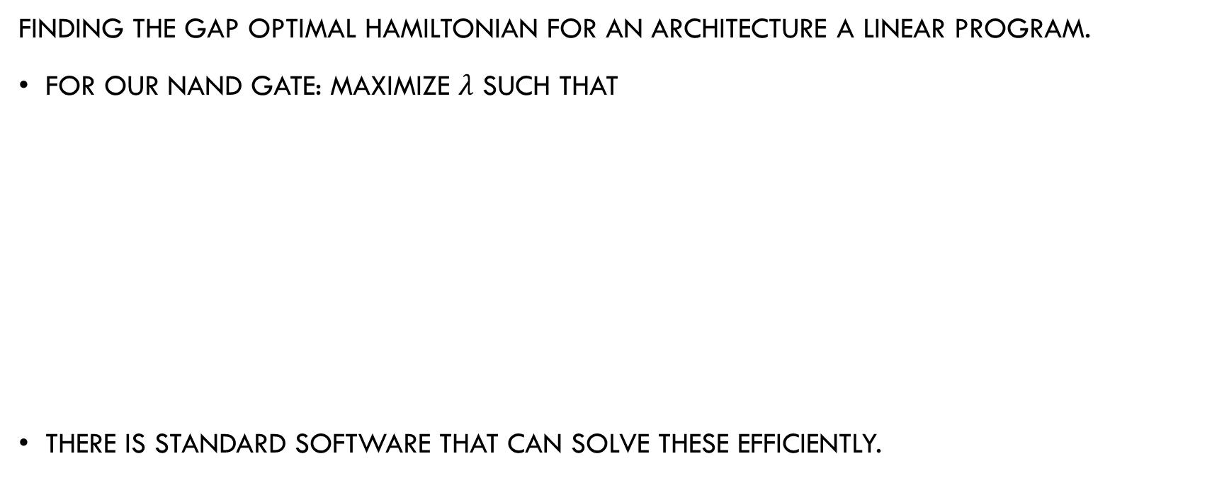
Linear Programming
Finding the gap optimal Hamiltonian for an architecture a linear program.
For our NAND gate: maximize $λ$ Such that
There is standard Software that can solve these efficiently.
$$0=c_{0}+c_{1}⋅1+c_{2}⋅0+c_{3}⋅0+c_{4}⋅0+c_{5}⋅0+c_{6}⋅0$$
$$0=c_{0}+c_{1}⋅1+c_{2}⋅1+c_{3}⋅0+c_{4}⋅0+c_{5}⋅1+c_{6}⋅0$$
$$0=c_{0}+c_{1}⋅1+c_{2}⋅0+c_{3}⋅1+c_{4}⋅0+c_{5}⋅0+c_{6}⋅1$$
$$0=c_{0}+c_{1}⋅0+c_{2}⋅1+c_{3}⋅1+c_{4}⋅1+c_{5}⋅0+c_{6}⋅0$$
$$λ≤c_{0}+c_{1}⋅0+c_{2}⋅0+c_{3}⋅0+c_{4}⋅0+c_{5}⋅0+c_{6}⋅0$$
$$λ≤c_{0}+c_{1}⋅0+c_{2}⋅1+c_{3}⋅0+c_{4}⋅0+c_{5}⋅0+c_{6}⋅0$$
$$λ≤c_{0}+c_{1}⋅0+c_{2}⋅0+c_{3}⋅1+c_{4}⋅0+c_{5}⋅0+c_{6}⋅0$$
$$λ≤c_{0}+c_{1}⋅1+c_{2}⋅1+c_{3}⋅1+c_{4}⋅1+c_{5}⋅1+c_{6}⋅1$$
Notes:
Expanding out the formula for a generic Hamiltonian shows that finding a gap-optimal Hamiltonian is a linear program.
The notation here can be a bit daunting. Recall:
The s^I terms means the function that multiplies the spin values at the indices contained the set I.
The C_I are the coefficients of the Hamiltonian, which are the variables of the linear program.
And finally, gamma is the spectral gap that separates feasible from infeasible behaviors.
In full generality there exponentially many variables, but for Ising models, and in particularly ones with sparse interaction graphs, there are not so many coefficients and so this is simple.

Slide 21

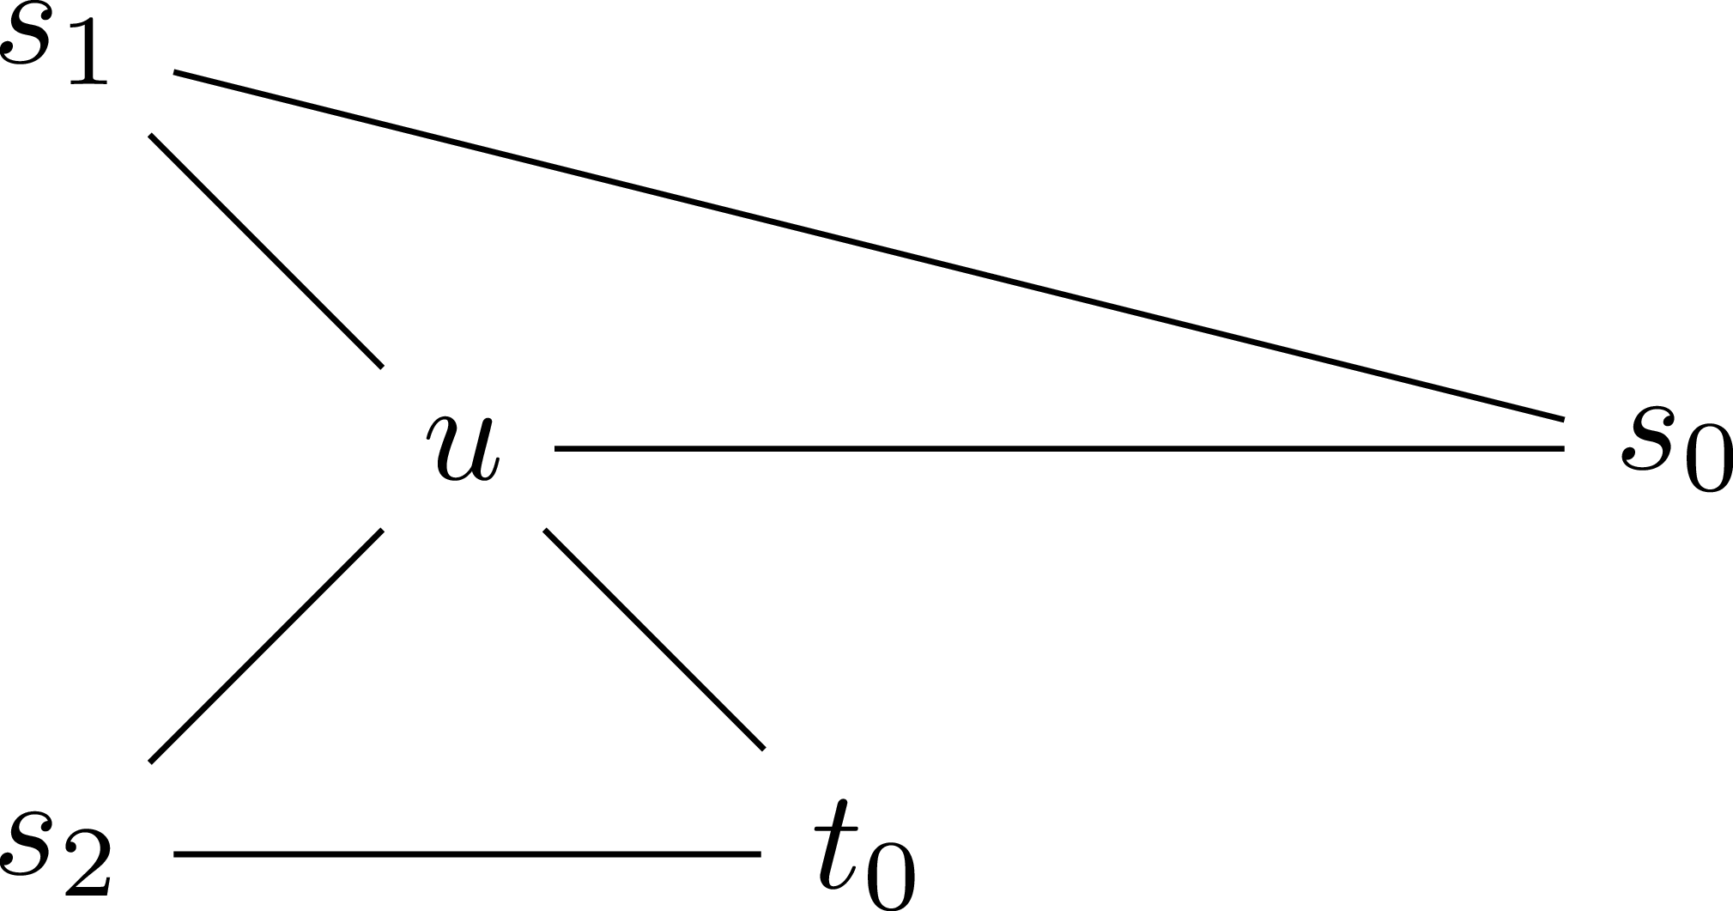
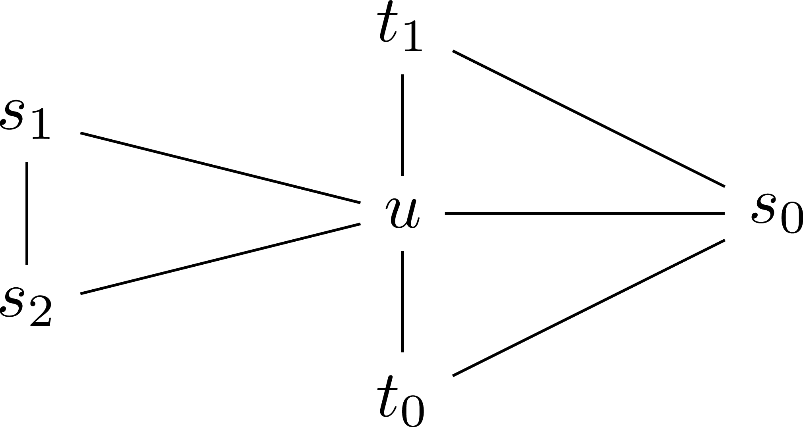
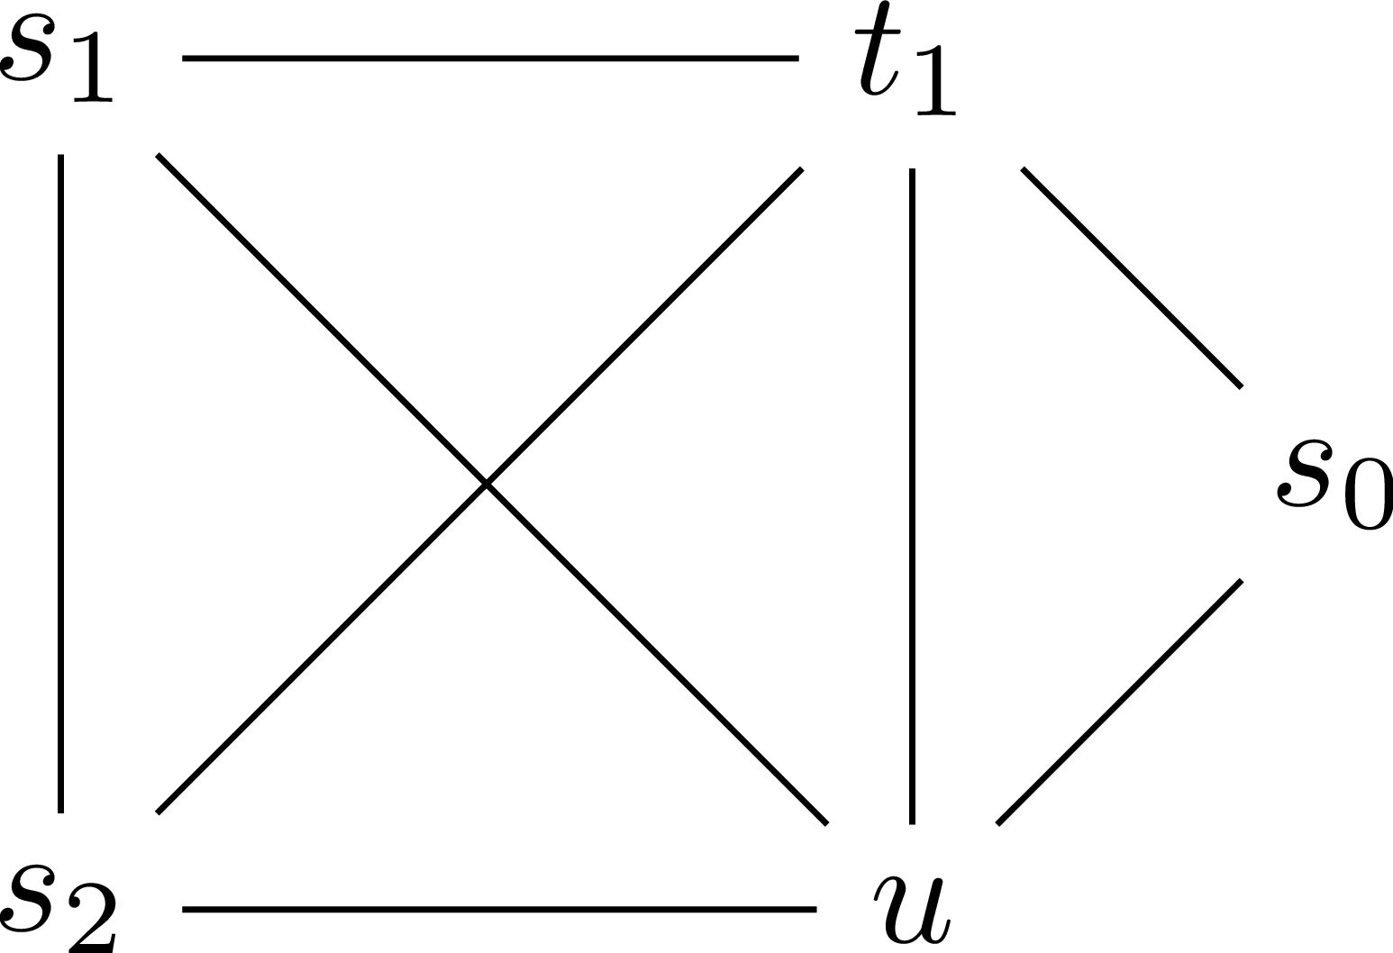

Can search on other “topologies”
We can put more constraints on our Polynomials
We only allow certain quadratic terms
Physical devices often have sparse interaction graphs
Input Bits
Output Bit
Ancillary Bit
Fault Bit

Slide 22
Solving Binary Optimization Problems

Slide 23
Standard Approaches
There are may classical Heuristic “local Search” methods
Greedy Search: flip the bit that reduces the penalty the most
  Gets stuck in local minima
TABU Search: Like greedy but uphill moves are allowed
  Previously visited states cannot be returned to
Simulated Annealing: Putative flip a random bit
  Accept the flip if the penalty is reduced
  Sometimes accept a penalty increase depending on a “temperature”
Notes:
Putting all this together, we can compile circuit fault diagnosis behaviors of individual components into gap-optimal Ising models over any architecture.
Generally, there are no such Hamiltonians, and one will need to add ancillary bits (and this leads to additional challenges).
Here we see some sparse interaction graphs that support gap-optimal Ising Hamiltonians (where a priori we allow for a complete interaction graph).

Slide 24
Physics-based solvers
Quantum Annealers use quantum effects to minimize energy
  have very restrictive topologies, so finding good mappings is often hard
Simulated Quantum Annealing: Monte-Carlo based on path-integrals
  Effectively simulates one type of quantum dynamics, but is quite slow
Parallel Tempering: Many Simultaneous runs of simulated annealing
  Different runs use different temperatures and can swap states
Substochastic Monte-Carlo: Monte Carlo approximation of Green’s function
  Exhibits the same tunneling behavior as quantum systems

Slide 25
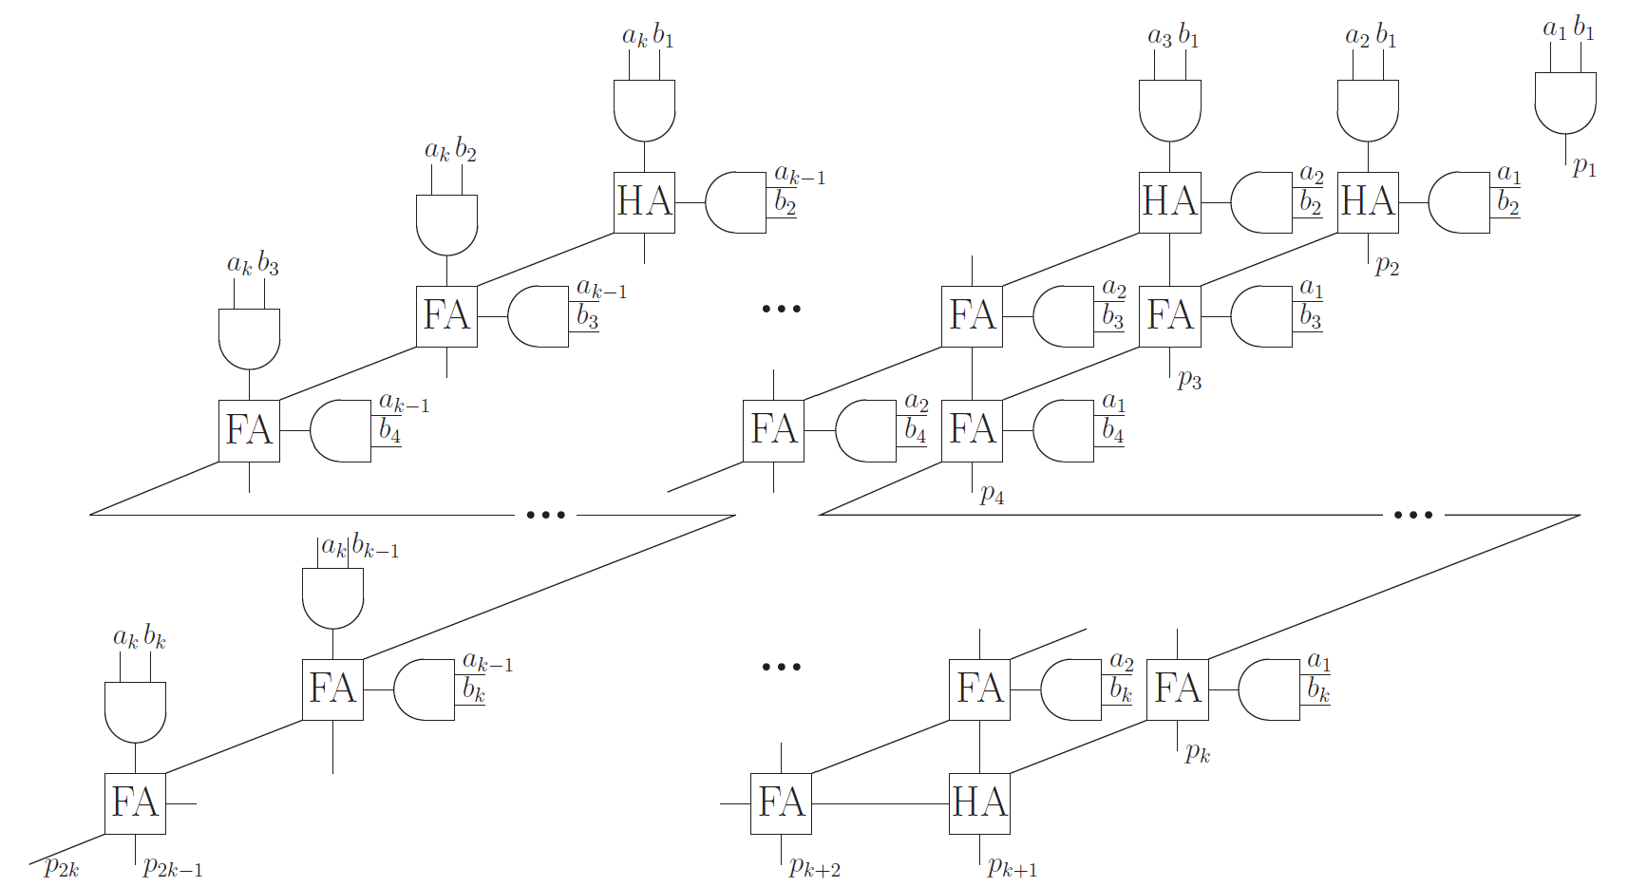
Benchmark problem
Fault diagnosis of Multiplier circuits of various widths.
Problem was proposed by IARPA

Slide 26
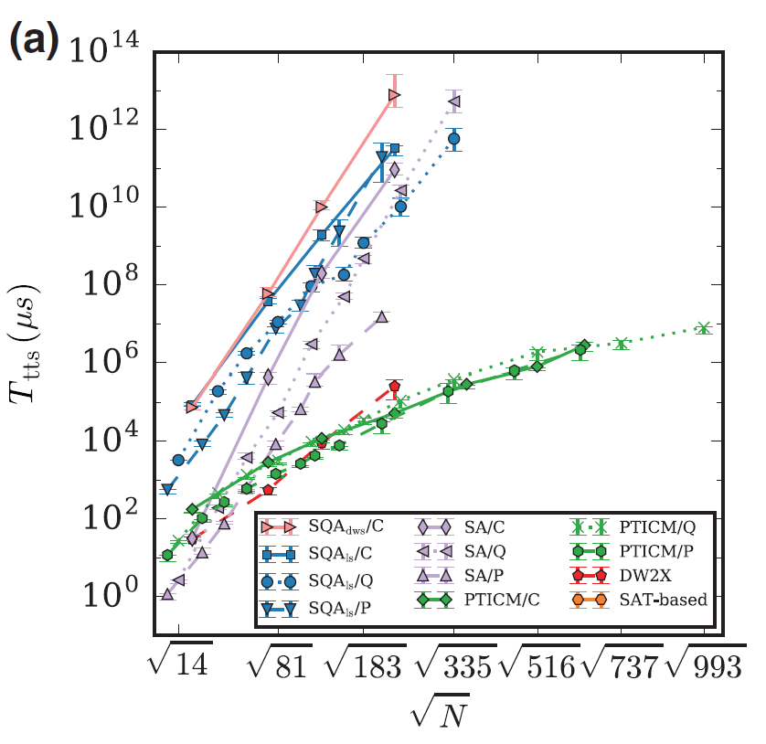
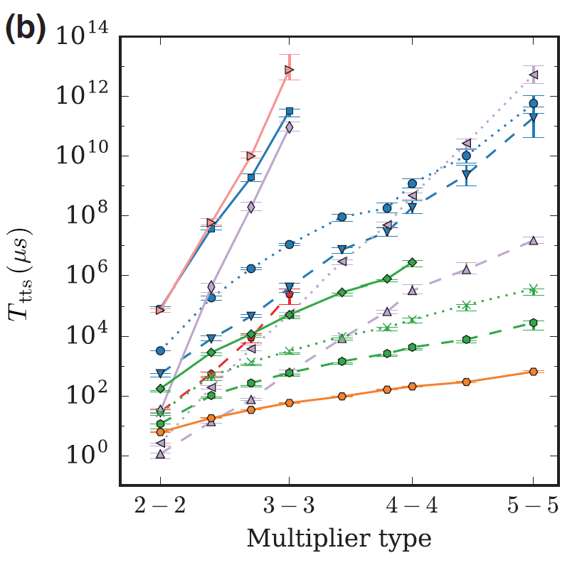
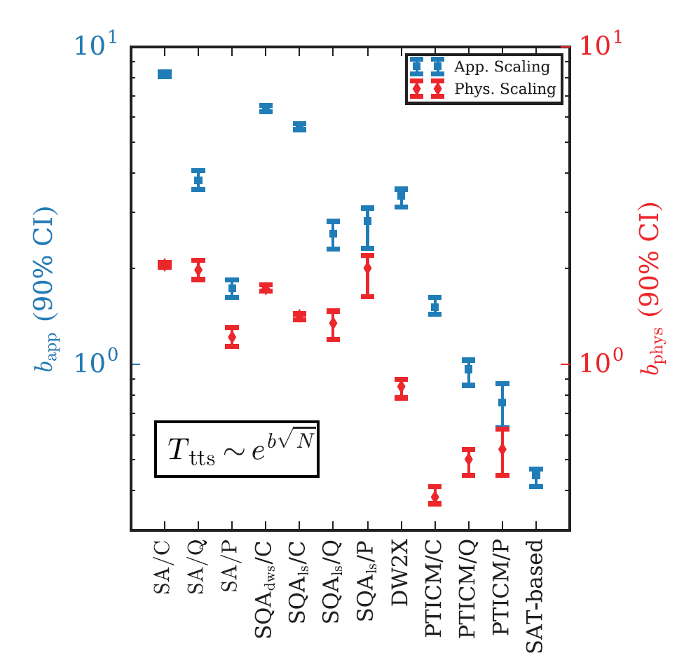
Comparison of numerous solvers
Perdomo-Ortiz, et al., Phys. Rev. Appl. 12:1, 2019.

Slide 27
Questions?

Slide 28
Appendix: Circuit examples

Slide 29
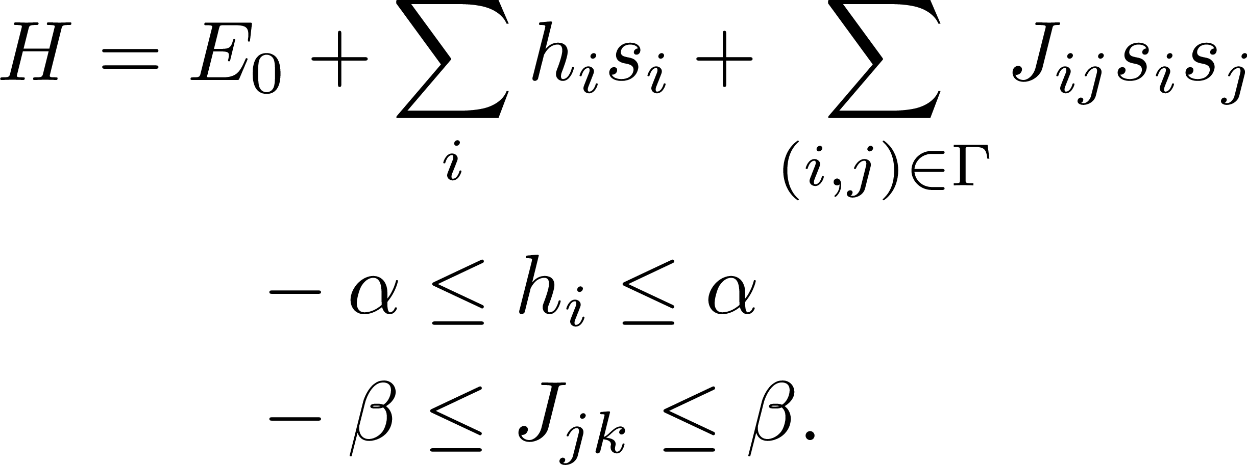
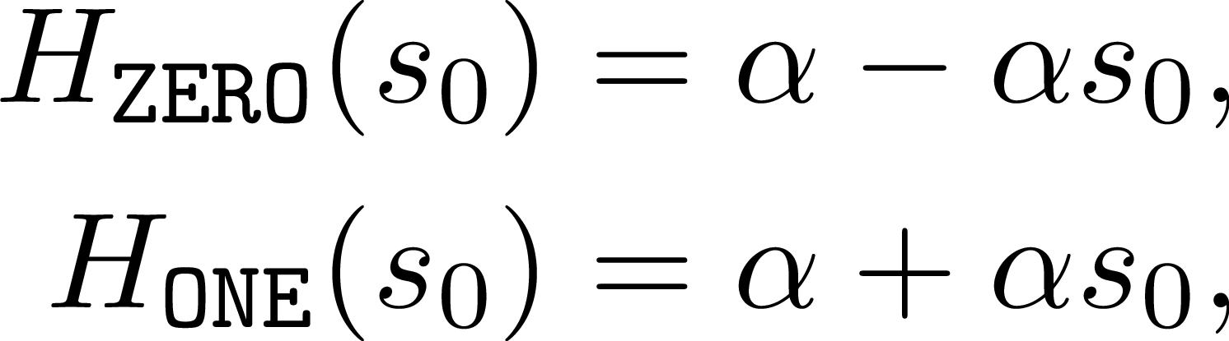
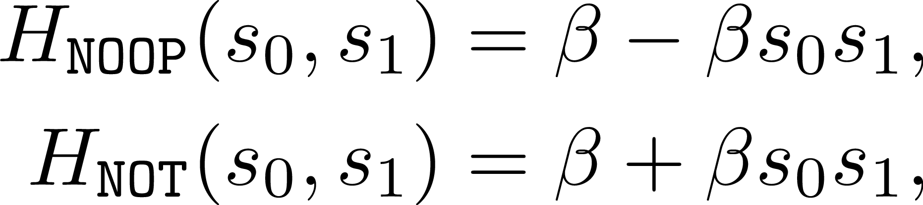
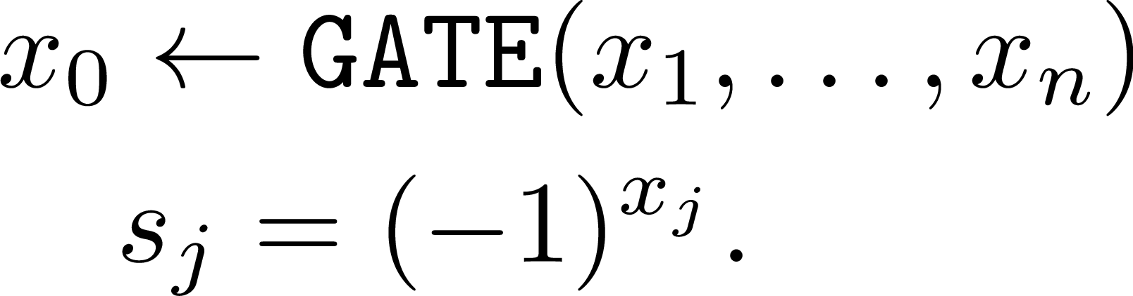
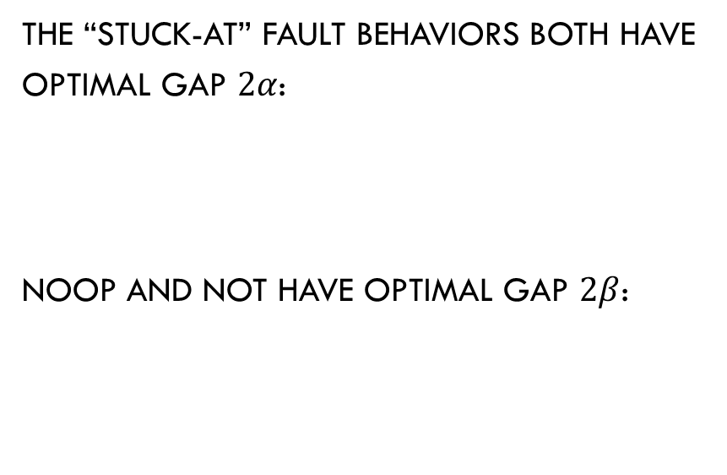
Basic examples
We target Hamiltonian architectures:
By convention we write
The “Stuck-at” fault behaviors both have optimal Gap $2α$:
noop and Not have optimal gap $2β$:

Slide 30
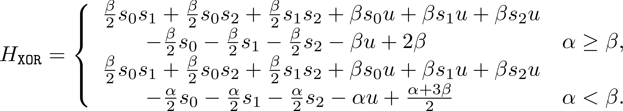
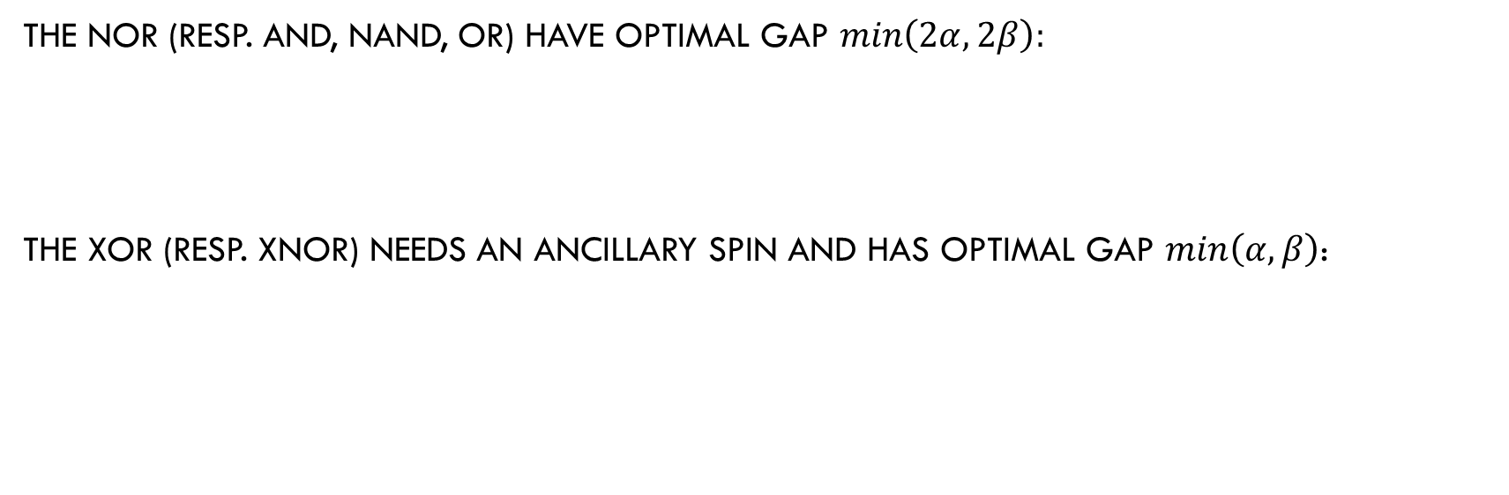
Binary gates
The NOR (resp. AND, NAND, OR) have optimal gap $min\left(2α,2β\right):$
The xor (resp. xnor) needs an ancillary spin and has optimal gap $min\left(α,β\right)$:

Slide 31
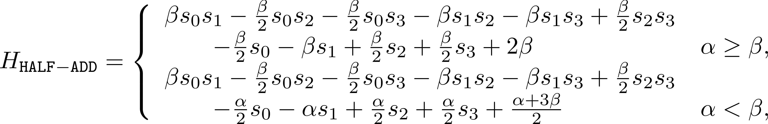
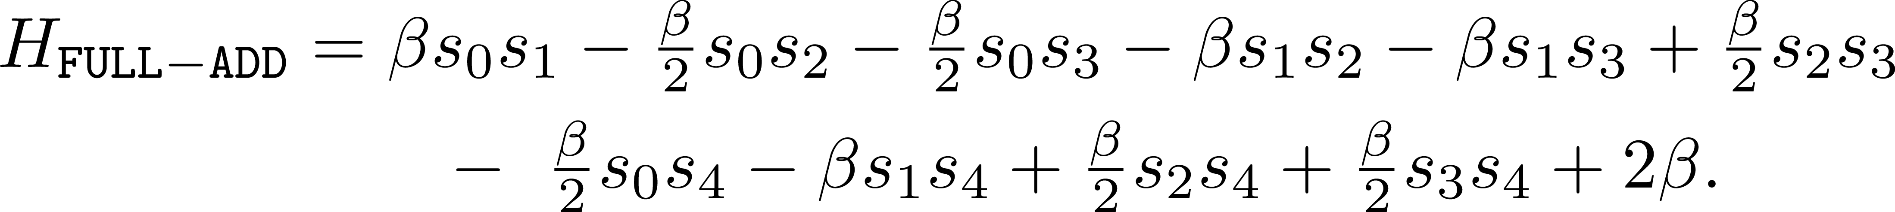
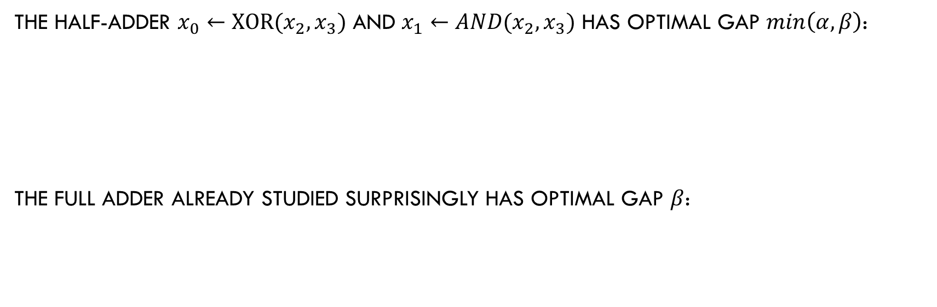
Adders
The half-adder $x_{0}←XOR(x_{2},x_{3})$ and $x_{1}←AND(x_{2},x_{3})$ has optimal gap $min\left(α,β\right)$:
The Full Adder already studied surprisingly has Optimal gap $β$:

Slide 32
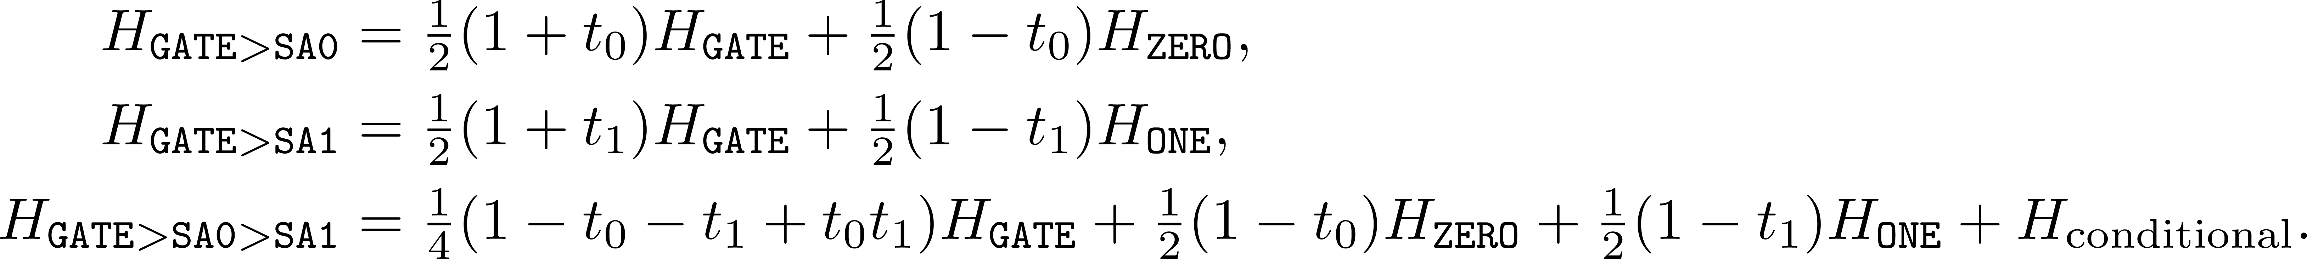
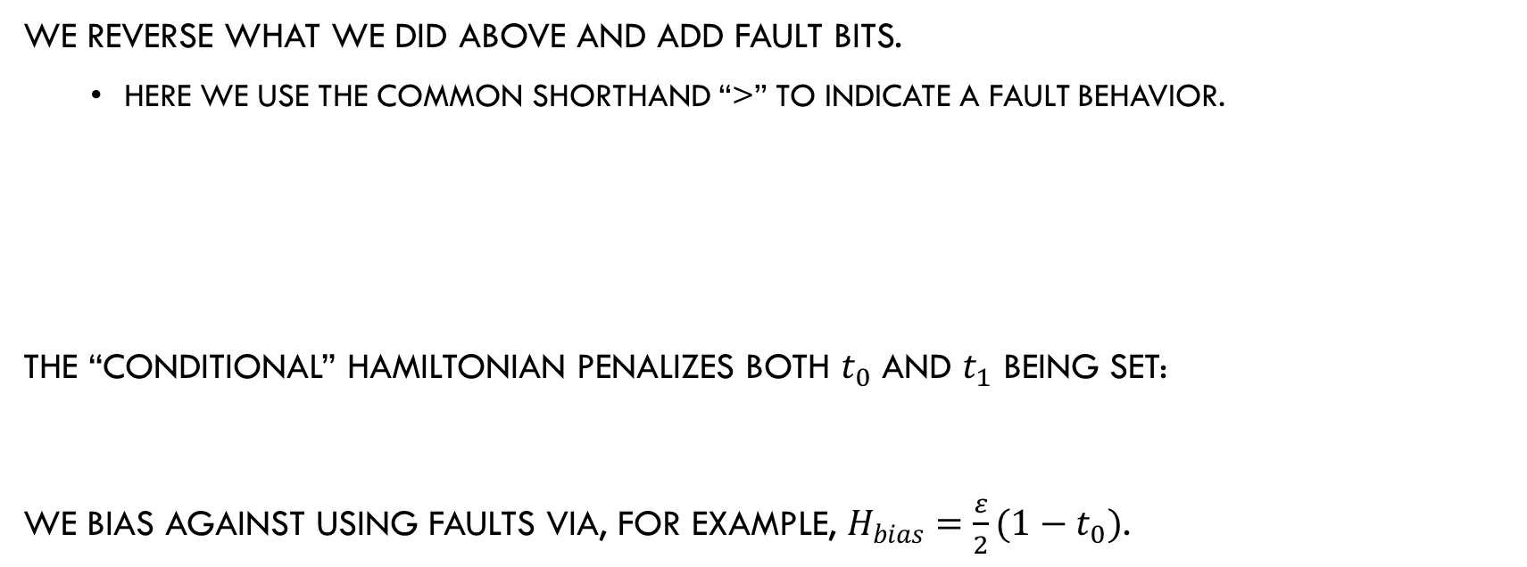
Adding Fault behaviors
We reverse what we did above and add fault bits.
  Here we use the common shorthand “>” to indicate a fault behavior.
The “conditional” Hamiltonian penalizes both $t_{0}$ and $t_{1}$ being set:
We bias against using faults via, for example, $H_{bias}=\frac{ε}{2}(1−t_{0})$.

Slide 33
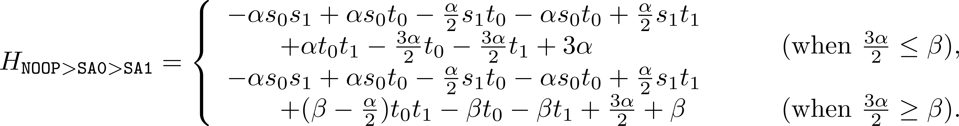
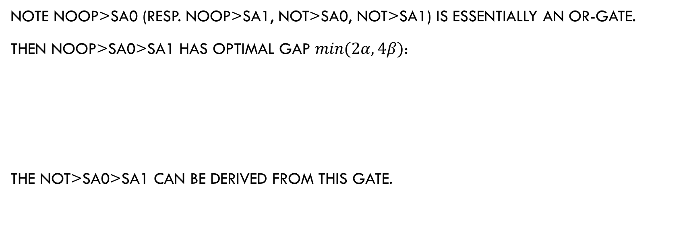
Unary Gates with Faults
Note NOOP>SA0 (resp. NOOP>SA1, NOT>SA0, NOT>SA1) is essentially an or-gate.
Then noop>SA0>SA1 has optimal gap $min⁡(2α,4β)$:
The Not>SA0>SA1 can be derived from this gate.

