Slide 1
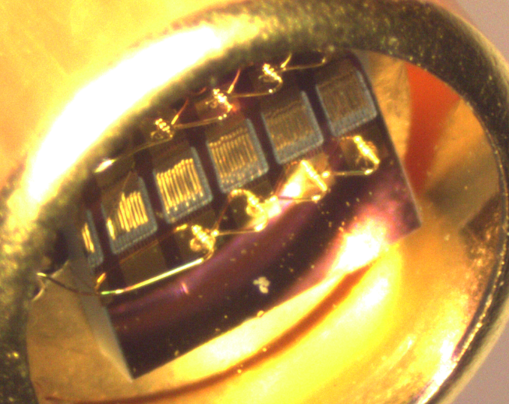
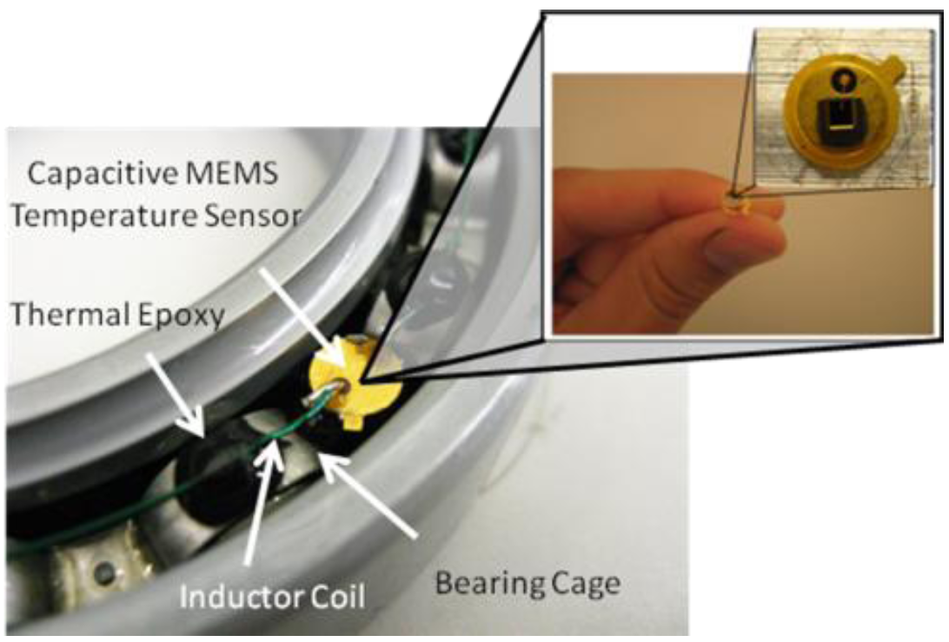
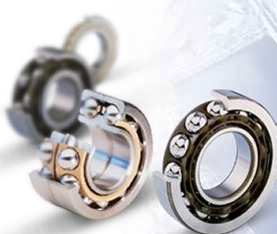
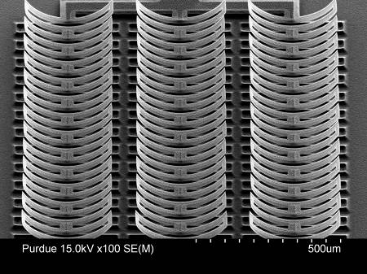
Wireless MEMS Bearing Sensors
Wireless battery-free RF MEMS bearing sensors
Monitor temperature > 500°C
Condition monitoring and failure monitoring: safety and green tech
Reduce required maintenance / hour of flight time
Accomplishments
First wireless integrated bearing sensor > 500°C
1B+ cycles at 250°C and > 3 months constant loading successfully passed (packaged sensors)
High-yield MEMS process
Hermetically sealed MEMS sensors
Projects/Recognition
Strong DoD and Industry engagement - collaboration with Prof. Sadeghi (ME)
Student research awards
Bearing Analytics: Purdue startup led by PhDs has licensed the technology (>$200k in startup competitions)

