Slide 1
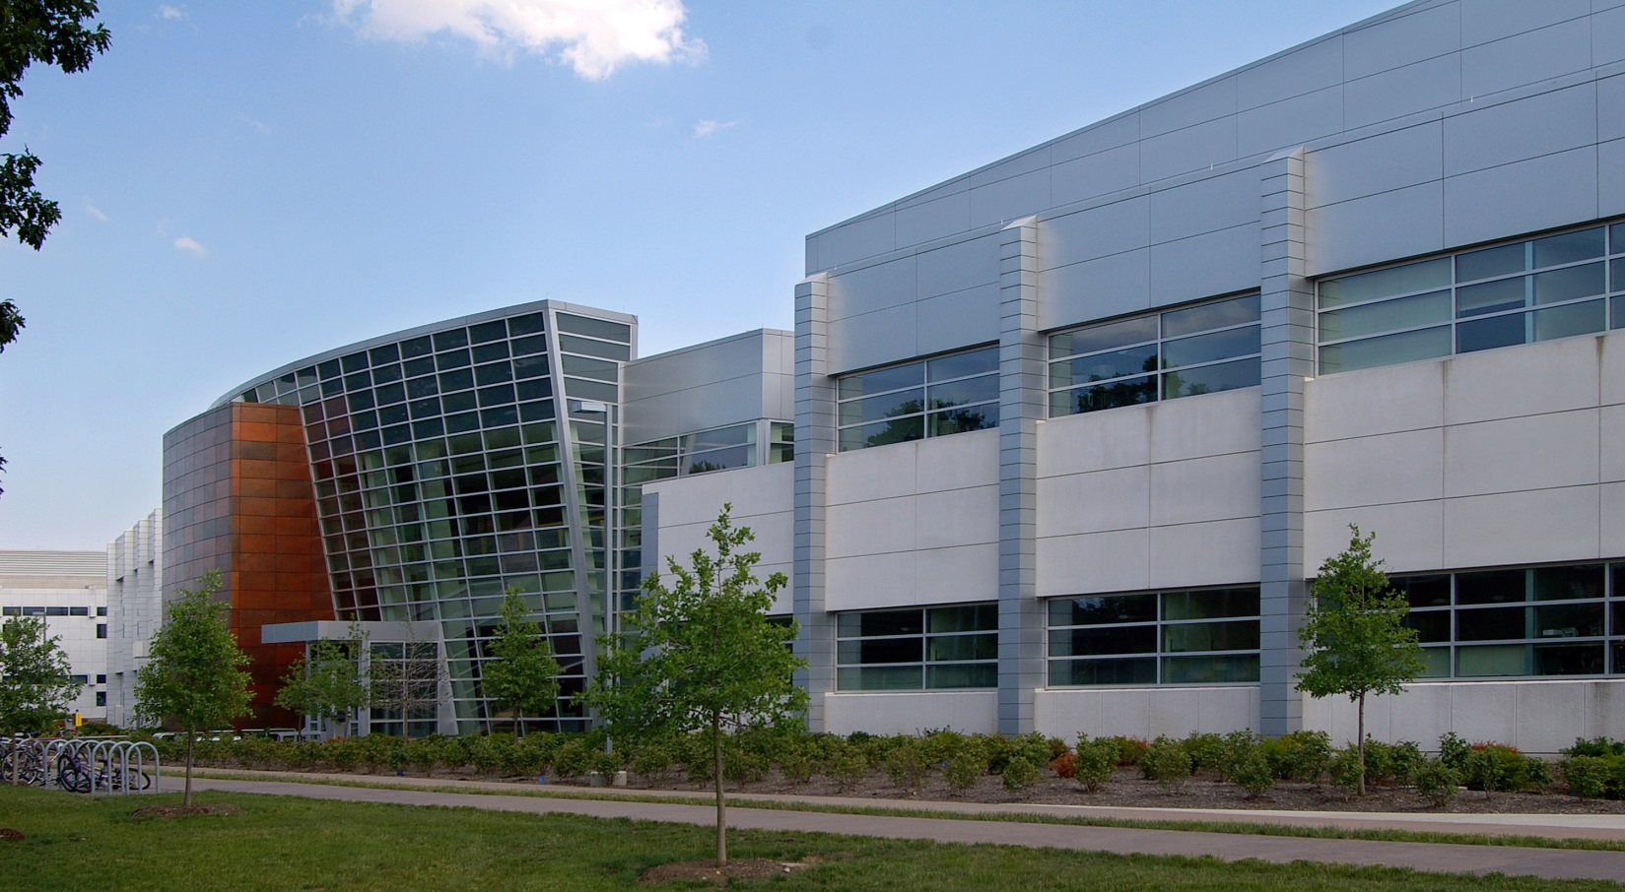
Friday, October 30, 2015
Save the Date !
Birck Nanotechnology Center
10th Anniversary Celebration
Discovery Lecture Series:
Nanotechnology Research beyond 2015
Nanotechnology at Purdue
BNC History and Prospects
Nanotech Madness
2-3 minute technical presentations
Commercialization and Nanotechnology
Birck Nanotechnology Center Tours
More information to follow

