Slide 1

Predatory Publishers: An Introduction and Toolkit
Megan Sapp Nelson
Professor
Purdue University Libraries and School of Information Studies

Slide 2

You Will:
Learning Objectives
Describe open access.
Differentiate predatory journals from open access journals.
Identify characteristics that will allow you to spot predatory journals.
Identify tools that will assist you to find reputable journals.

Slide 3
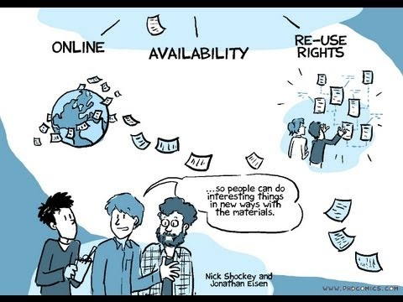
Why Open Access?
A Brief Introduction from PhD Comics

Slide 4
How Are Predatory Journals Different?
Exploitation of the Open Access Model for the Purpose of Making Money
Open access journals of questionable quality and with exploitative business models
Little or no quality control
Don’t provide editing or peer review
Mimic the names and formatting of well-known journals
List well-known researchers as editors without their knowledge or permission
Use flattering direct emails to entice researchers to submit articles
Hide publication fees that can range from hundreds to thousands of dollars

Slide 5
NIH Statement on Article Publication
Resulting from NIH Funded Research
“The NIH has noted an increase in the numbers of papers reported as products of NIH funding which are published in journals or by publishers that do not follow best practices promoted by professional scholarly publishing organizations. These journals and publishers typically can be identified by several attributes, including:
misleading pricing (e.g., lack of transparency about article processing charges);
failure to disclose information to authors;
aggressive tactics to solicit article submissions;
inaccurate statements about editorial board membership; and
misleading or suspicious peer-review processes.
Publications using such practices may call into question the credibility of the research they report.
Recommendations to identify credible journals
To help protect the credibility of papers arising from its research investment, NIH encourages its stakeholders, including grantees, contractors, intramural researchers, and librarians, to help authors:
Adhere to the principles of research integrity and publication ethics;
Identify journals that follow best practices promoted by professional scholarly publishing organizations; and
Avoid publishing in journals that do not have a clearly stated and rigorous peer review process.”

Slide 6
Suggested Tools for Identifying Reputable Journals
Think Check Submit – thinkchecksubmit.org
Checklist to work through to ensure that you are not submitting to a predatory journal. Many of the tools below are factored into this checklist.
JournalGuide – journalguide.com
List of 46,000 journals. Allows you to compare impact, publication speed, cost, and open access options.
Beall’s List of Potential Predatory Journals and Publishers- archived in 2017 – beallslist.net
The most comprehensive existing list of predatory journals and publishers. Created by a librarian. No longer updated because a publisher took the librarian to court.
Directory of Open Access Journals (DOAJ) – doaj.org
A vetted listing of reputable open access journals.
Open Access Scholarly Publishers Association – oaspa.org
Trade organization for reputable open access publishers. Membership list indicates scholarly reputation.
Committee on Publication Ethics - https://publicationethics.org/members
Trade organization specifically creating guidance for open access publishers and editors
to counter predatory practices.

